Slide 1
New Reactor Antineutrino Spectra
T.A. Mueller, D. Lhuiller, M.Fallot, A. Letourneau,
S. Cormon, M. Fechner, L. Giot, T. Lasserre, J. Martino,
G. Mention, A. Porta, F. Yermia.
CEA Saclay – Irfu
Subatech Nantes
arXiv:1101.2663

Slide 2
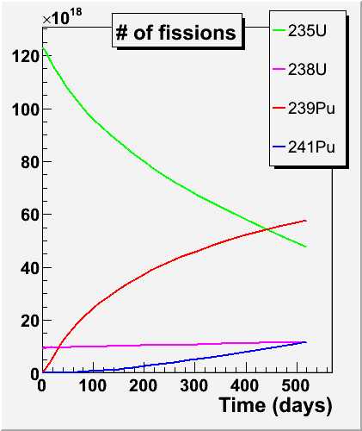
ν spectrum emitted by a reactor
The prediction of reactor ν spectrum is the dominant source of systematic error for single detector experiments
Reactor evolution codes
Reactor data
Fraction of fissions from isotope k, δα_{k}=few % but large anti-correl @ fixed P_{th}
Thermal power, δPth ≤1%
Nuclear databases
E relased per fissions of isotope k, δΕ_{k}≈0.3%
ν spectrum per fission
This work !

Slide 3
Theory

Slide 4
The guts of S_{k}(E)
Sum of all fission products’ activities
Sum of all β-branch of each fission product
Theory of β-decay

Slide 5
Available Data

Slide 6
e⁻ spectrum ν spectrum
Exact conversion requires complete knowledge from fission yield down to β-transition between parent ground (or isomeric)-state and daughter states
β-branch level
Fission product level
Lot of relevant quantities: Z, A, End-points, J^{π}, nuclear matrix elements, branching ratios, fission yields, life time… but scarce data as E₀ increases → integral electron spectra.

Slide 7
Complementary approaches
Integral measurements
Ab initio
Sum of all fission products’ activities
fission product inventory (t)
fission rates (t)
Fission Yields (JEFF, ENDF, JENDL)
Life time
Sum of all β-branch of each fission product
Build total spectrum from sum of β-branches
Reference spectrum per isotope
Complete β-decays schemes (ENSDF)
β-strength (Greenwood et al.)
Total β spectrum per nucleus (Rudstam et al.)
Masses (Q_{β})
Nuclear models …
ILL data
Theory of β-decay

Slide 8
Anchor point of ILL electron data
Accurate measurements @ ILL in the 80’s:
Total electron spectra from the β-decays of ²³⁵U, ²³⁹Pu and ²⁴¹Pu fission products.
High resolution magn. spectrometer
Intense and pure thermal neutron spectrum from the core.
Extensive use of reference internal conversion electron lines
→ Normalization
→ Shape via ε_{det}(E)
Unique reference to be met by any other measurement or calculation

Slide 9
Normalization of ILL electron data
Stack of quadratic sum of ²³⁵U errors
Dominant source of error
Treatment of correlations is non trivial due to the use of independent reactions to cover the energy range
- Bin to bin correl for a given isotope?
- Isotope to isotope correl?
Taken as 100% correl for now in both cases.
¹¹⁶Sn(γ,e⁻)¹¹⁶Sn
¹¹³Cd(n,γ)¹¹⁴Cd
²⁰⁷Pb(n,e⁻)²⁰⁸Pb

Slide 10
ILL data: conversion to ν spectra
Lost info of single β-branches → fit e⁻ (50 keV bins) spectrum with a sum of 30 effective branches
All theory included in these effective branches but:
- What Z? : Mean fit on nuclear data Z=f(E0)
- What A_{CW}? : effective correction
Conversion error from envelop of all numerical studies
Stack of quadratic sum of ²³⁵U errors

Slide 11
Improved ab initio approach

Slide 12
Ab initio approach… do we have the guts?
MURE evolution code: core composition and off equilibrium effects
(Subatech Nantes)
Relative change of ν spectrum w.r.t. infinite irradiation time
Full simulation of reactor core
→ absolute prediction of isotopes inventory.
Relative off-equilibrium effect: close to beta-inverse threshold, a significant fraction of the ν spectrum takes weeks to reach equilibrium
→ Sizeable correction in the ν oscillation range that depends on the exact chronology of ILL data taking.
ILL conditions

Slide 13
Ab initio approach… do we have the guts?
BESTIOLE code: build up database of ~ 800 nuclei and 10000 β-branches
All data from ENSDF (β-branches) and JEFF (fission yields) databases
+
Complementary measurements of fission products spectra to tag and replace pandemonium candidates
+
Unmeasured nuclei described by gross-theory (JENDL database) + our own model based on ENSDF mean fits.
Residues w.r.t. reference ILL e⁻ data
→ 95+/-5% of the spectrum reproduced but still not meeting required precision
(more studies going on)
→ Useful estimate of ²³⁸U spectrum which couldn’t be measured @ ILL

Slide 14
²³⁸U spectrum
Comparison with Vogel’s calculations, Phys. Rev. C24, 1543 (1981)
ν residues
ν
e⁻

Slide 15
²³⁸U spectrum
First propagation of all ENSDF quoted errors + correlations.
Demonstrate that uncertainty on shape factors has ≤1.5% impact on total spectrum.
Total error dominated by (safe) estimate of syst of nuclear databases in the 10-20% range but good enough for the 10% contrib. of ²³⁸U to reactor spectrum.
Stack of quadratic sum of ²³⁸U errors
Eager to see release of FRM2 electron data !

Slide 16
Improved conversion

Slide 17
Mixed approach
“True” distribution of β-branches: ENSDF + pandemonium corrected data set reproduces ~90% of ILL e⁺ data.
Reduce use of effective β-branches to the remaining 10%.
→ Same high quality e⁻ anchor point with greatly improved set of β-branches for the conversion.

Slide 18
Deviation from ILL converted spectrum
(New-ILL)/ILL
~+3% normalization shift with respect to ILL converted ν spectrum
Similar result for all isotopes.
+3%

Slide 19
Cross-checks
Stringent test
Define “true” e⁻ and ν spectra from reduced set of kell-known ENSDF branches.
Apply exact same ILL conv procedure to true e⁻ spectrum.
Compare converted ν spectrum to the true one.
+ confirmations via numerous ways to fit the e⁻ ILL spectrum:
Change number and shape of effective branches
Change the set of initial physical β-branches
Replace effective branches by distortions of BR or FY or E₀ distributions, or any combination

Slide 20
Origin of the 3% shift
A_{C,W} at branch level
E <4 MeV: deviation from effective linear A_{C,W} correction of ILL data
Effective A_{C,W}
E >4 MeV: mean fit of Z(E₀) doesn’t take into account the very large dispersion of Z around the mean curve

Slide 21
Error budget
Normalization error from e⁻ data (assumed 100% correlated for the 3 ILL isotopes).
The conversion error comes from an empiric x3 rule observed along all tentative fits. Access to original 50 keV e⁻ bins would reduce fit residues and conversion error…
A_{CW} error: envelop of results with 100% uncertainty on this correction.
The anchor point of ILL e⁻ data suppresses the sensitivity to perturbations around the physical distributions

Slide 22
Error budget
²³⁵U bin-to-bin correlation matrix
(25x25 bins, 2-8 MeV)
Stack of quadratic sum of ²³⁸U errors
(100% bin to bin correl from norm and A_{CW})

Slide 23
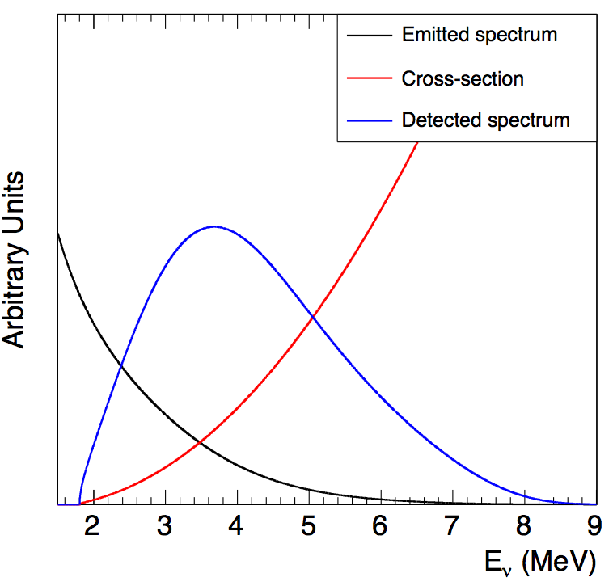
Summary
Mixed approach: reference ILL e⁻ data described by:
- As many physical branches (90%)
- Reduced amount of effective branches (10%)
- Careful implementation of available corrections to Fermi theory
→ A +3% shift of emitted flux w.r.t. ILL data.
→ Reanalysis of reactor experiments.
See Max’s talk.
 | Emitted <Residue> in [2-8] MeV | Detected <Flux ratio> in [2-8] MeV
²³⁵U | +3.0% | +2.5%
²³⁹Pu | +3.5% | +3.1%
²⁴¹Pu | +4.3% | +3.7%
²³⁸U | +6.2% | +7.8%

Slide 24
Outlook - Discussion
More refined treatment of normalization error (impact on global fit of reactor experiments).
Exploit ILL e⁻ data in 50 keV bins (reduce conversion error)
Better estimate of A_{C,W} corrections and associated error?
Details on chronology of ILL measurement for more accurate off-equilibrium effects.

Slide 25
Backup Slides

Slide 26
Pandemonium
Bias of β-decay scheme deduced from (e⁻,γ) coincidence:
Ε
γ
0
^{A}
_{Z} N
ε^{det} drops
fast with E_{γ}
+
difficult analysis
of continuum
β⁻
0
^{A}
_{Z-1}N’
- Underestimation of the low E part of the spectrum
Overestimation of the high E part
- Missed γ are attributed to GS transition.
Solution is Total Absorption Gamma Spectrometers (detect total E of γ chain)

Slide 27
A_{C,W}
Assume 100% error on final correction
Error taken as the envelop of converted spectra
Numerical studies show 100% bin to bin correlation

Slide 28
Z versus End-point energy

Slide 29
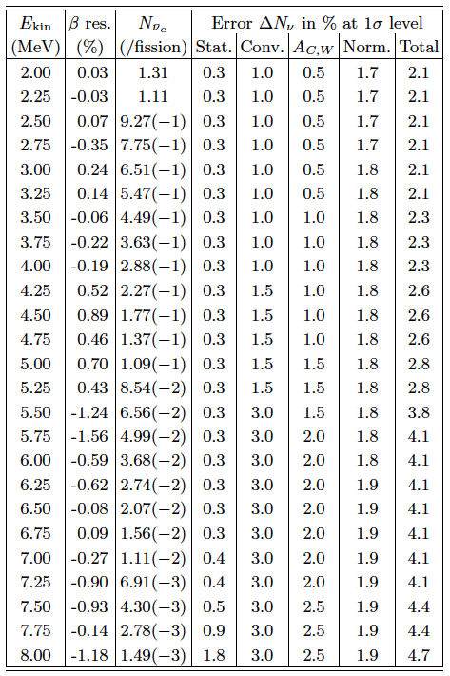
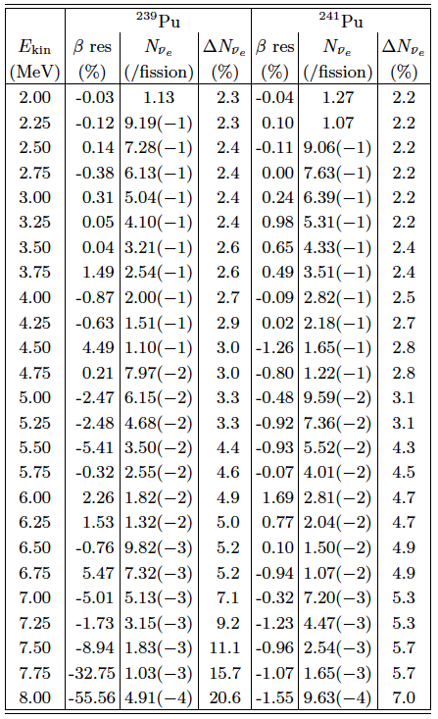
Error budget
²³⁵U
²³⁹Pu
²⁴¹Pu

