Slide 1
Physics Potential of the LENA Detector
Epiphany Conference
Cracow
January 8, 2010
Michael Wurm Technische Universität München

Slide 2
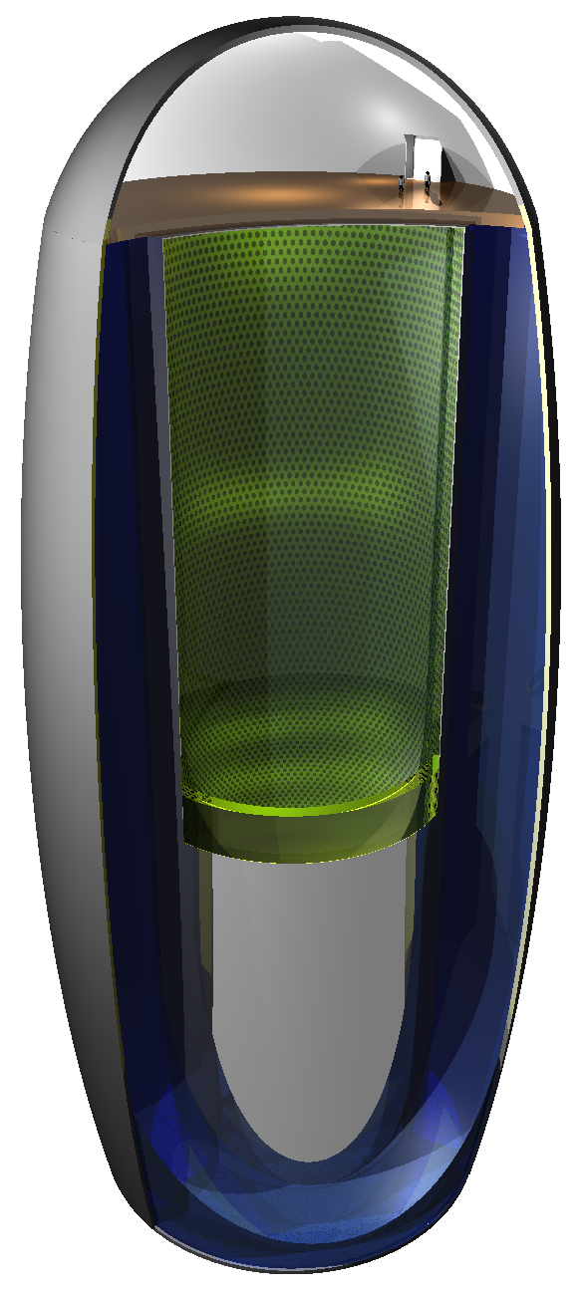
LENA
Low-Energy Neutrino Astronomy
Large-volume (50kt) liquid-scintillator detector
Outline
Detector Layout
Low Energy Physics
Potential for High Energies
Current R&D Activities
Michael Wurm, TUM Physics with LENA 1/24

Slide 3
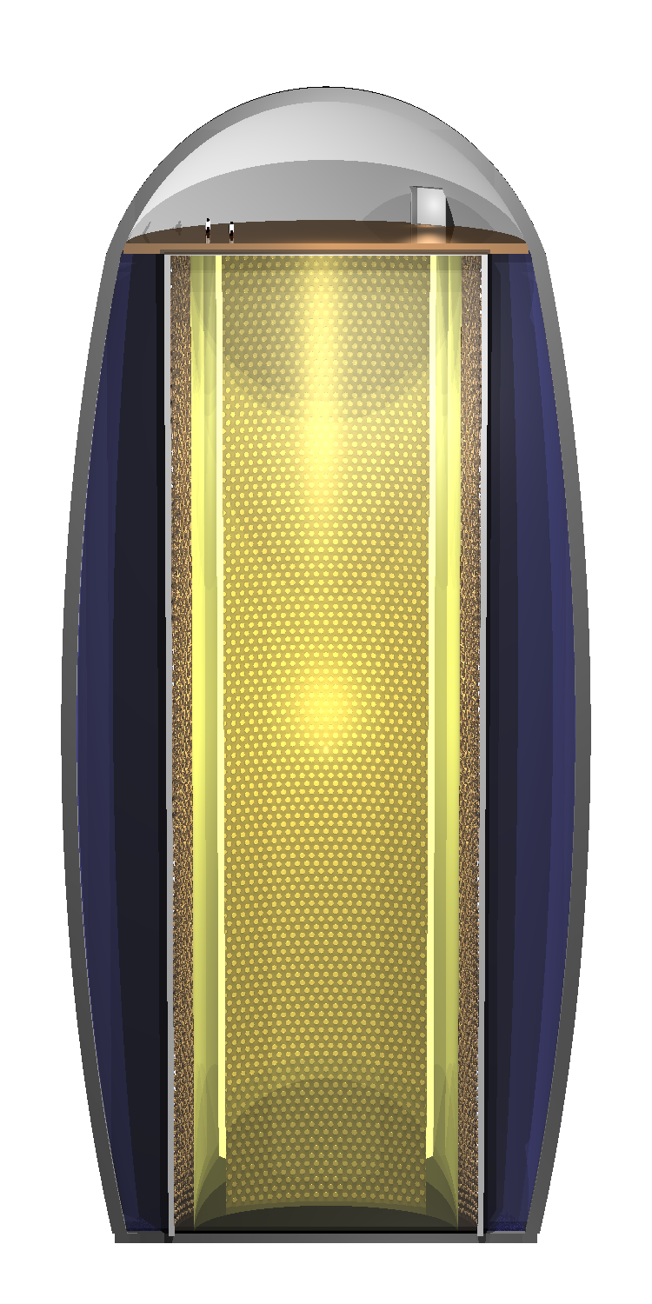
Detector Layout
Liquid Scintillator ca. 50kt PXE/LAB
Inner Nylon Vessel radius: 13m Buffer Region inactive, Δr = 2m Steel Tank, 13500 PMs r = 15m, h = 100m, optical coverage: 30% Water Cherenkov Veto 1500 PMTs, Δr > 2m fast neutron shield Egg-Shaped Cavern about 10⁵ m³
Overburden: 4000 mwe
in total 70 ktons of organic solvent, LAB favoured
design based on experience with Borexino
tank diameter governed by liquid transparency
optimization of PM configuration is on-going
Michael Wurm, TUM Physics with LENA 2/24
Notes:
500 pe is 1 MeV

Slide 4
Low Energy Physics
Physics Objectives
Neutrinos from galactic Supernovae
Diffuse Supernova neutrinos
Solar neutrinos
Geoneutrinos
Indirect dark matter search
Reactor neutrinos
Detector Performance
Good energy resolution
Low detection threshold
Excellent background discrimination
Low background by purification
No directional resolution
Michael Wurm, TUM Physics with LENA 3/24

Slide 5
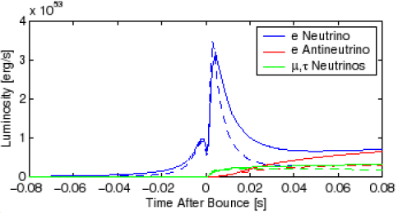
Galactic SN Neutrinos in LENA
ν_{e} from neutronisation burst νν pairs of all flavors from protoneutronstar cooling
For “standard“ SN (10kpc, 8M): ca. 13k events in 50kt target
_
Channel | Rate | Threshold (MeV) | Spectrum
ν_{e} p → n e⁺ | 8900 | 1.8 | ✓
ν_{e}¹²C →¹²N e⁻ | 200 | 17.3 | (✓)
ν_{e}¹²C →¹²B e⁺ | 130 | 13.4 | (✓)
ν ¹²C →¹²C* ν | 860 | 15.1 | ✗
ν p → p ν | 2200 | 1.0 | ✓
ν e⁻ → e⁻ ν | 700 | 0.2 | ✓
_
Michael Wurm, TUM Physics with LENA 4/24

Slide 6
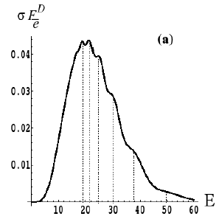
Scientific Gain of SN Observation
Astrophysics
Observe neutronisation burst
Cooling of the neutron star flavor-dependent spectra and luminosity, time-dev.
Propagation of the shock wave by envelope matter effects
SNEWS
Neutrino physics
Survival probability of ν_{e} in neutronisation burst P_{ee} ≈ 0 → normal mass hierarchy
Resonant flavor conversions in the SN envelope: hierarchy, θ₁₃
Earth matter effect: ν mass hierarchy, θ₁₃
Observation of collective neutrino oscillations
more exotic effects ...
Michael Wurm, TUM Physics with LENA 5/24

Slide 7
Diffuse SN Neutrinos in LENA
Regular galactic Supernova rate: 1-3 per century Alternative access:
isotropic ν background generated by SN on cosmic scales
redshifted by cosmic expansion
flux: 100/cm²s of all flavours
rate too low for detection in current neutrino experiments In LENA: 4-30 ν_{e} per year (50kta)
_
Michael Wurm, TUM Physics with LENA 6/24

Slide 8
Background in Liquid Scintillators
Detection via Inverse Beta Decay
ν_{e}+p → n+e⁺
allows discrimination of most single-event background limiting the detection in SK
Remaining Background Sources
reactor and atmospheric ν_{e}‘s
cosmogenic βn-emitters: ⁹Li
fast neutrons
solar ν_{e}‘s
neutrons from atm. ν‘s (NC on ¹²C)
Expected rate: 2-20 ev/50kta (in energy window from 10-25MeV)
_
_
_
Scientific Gain
first detection of DSN
information on SNν spectrum
Michael Wurm, TUM Physics with LENA 7/24

Slide 9
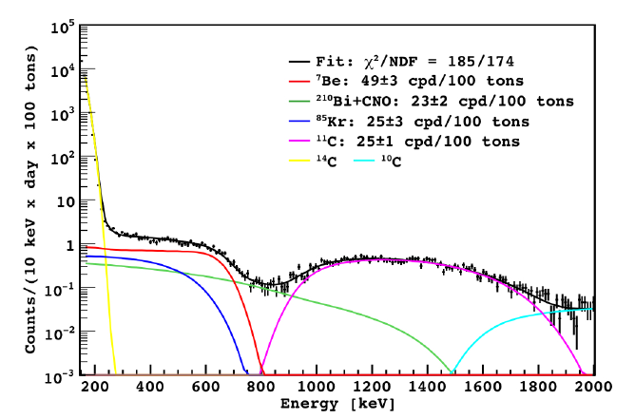
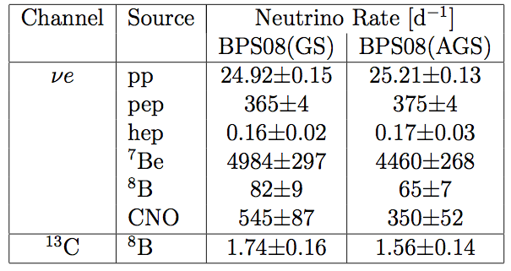
Solar Neutrinos in LENA
[Borexino, arXiv:0805.3843]
Detection Channel
elastic νe scattering, E > 0.2MeV
Background Requirements
U/Th concentration of 10⁻¹⁸ g/g (achieved in Borexino)
shielding of >3500 mwe for CNO/pep-ν measurement
Scientific Motivation
determination of solar parameters (e.g. metallicity, contribution of CNO)
search for temporal modulations in ⁷Be-ν (on per mill level)
probe the MSW effect in the vacuum transition region → new osc. physics
search for ν_{e} → ν_{e} conversion
⁷Be-ν
¹¹C
²¹⁰Bi
⁸⁵Kr
CNO/pep-ν
(18kt)
_

Slide 10
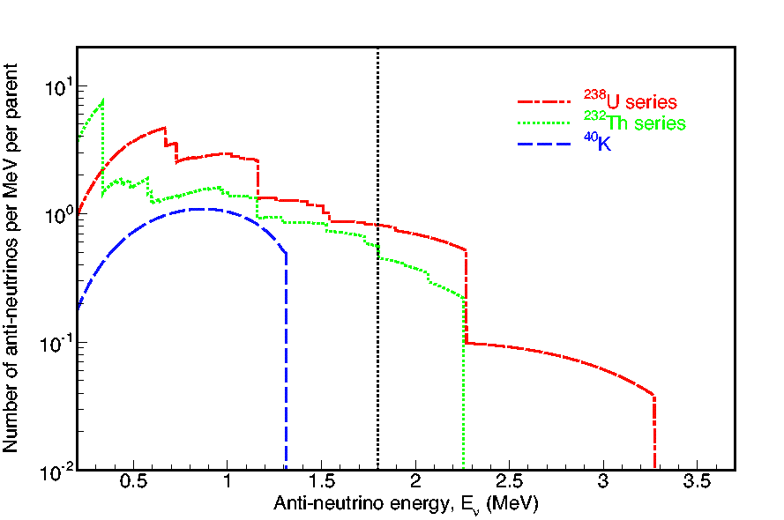
Geoneutrinos
IBD threshold of 1.8 MeV ν_{e} by U/Th decay chains At Pyhäsalmi expected rate 2x10³ / 50 kta reactor-ν bg 700
Scientific Gain
determine Urey-ratio (U/Th)
measure contribution of U/Th decays to Earth‘s total heat flow
with several detectors at different sites: disentangle oceanic/continental crust
hypothetical georeactor
_

Slide 11
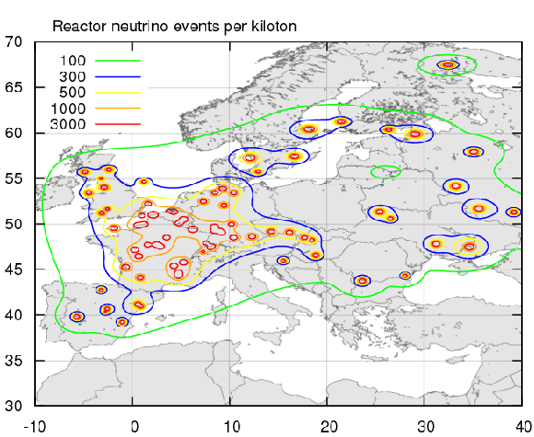
Influence of Detector Location
K. Loo
Michael Wurm, TUM Physics with LENA 10/24

Slide 12
Potential at Higher Energies
Physics Objectives
Proton decay
Long-baseline neutrino beams
Atmospheric neutrinos
Detector Properties
depends on tracking and particle identification capabilities
all particles are visible
some experience from cosmic muons in Borexino/KamLAND
Michael Wurm, TUM Physics with LENA 11/24

Slide 13
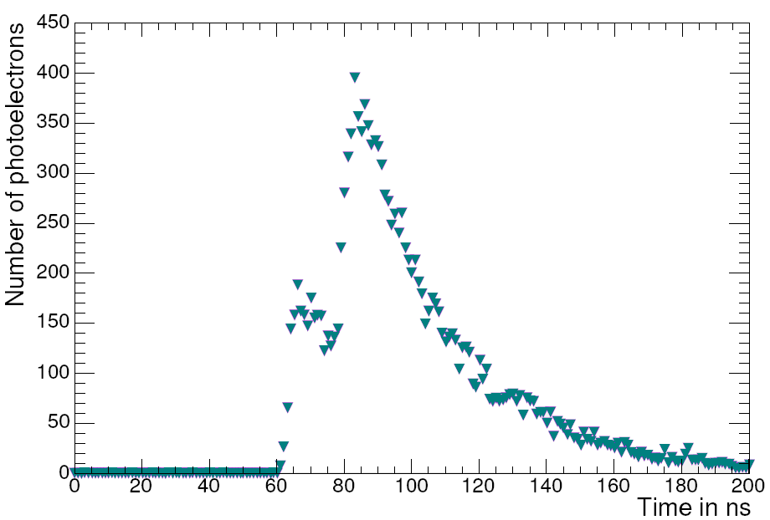
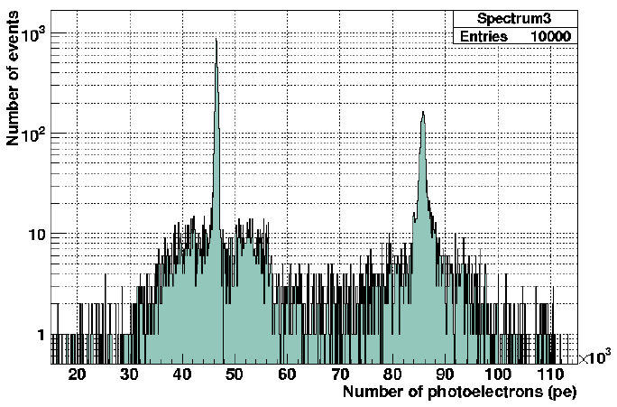
Proton Decay into K⁺ν
_
_
Signature p → K⁺ ν  μ⁺ν_{μ} / π⁰π⁺
coincidence: τ_{K} = 13 ns energy: 250-450 MeV modified by Fermi motion for ¹²C
Michael Wurm, TUM Physics with LENA 12/24

Slide 14
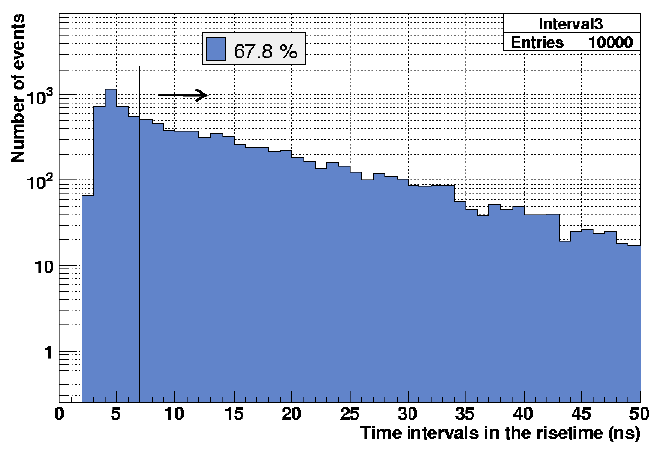
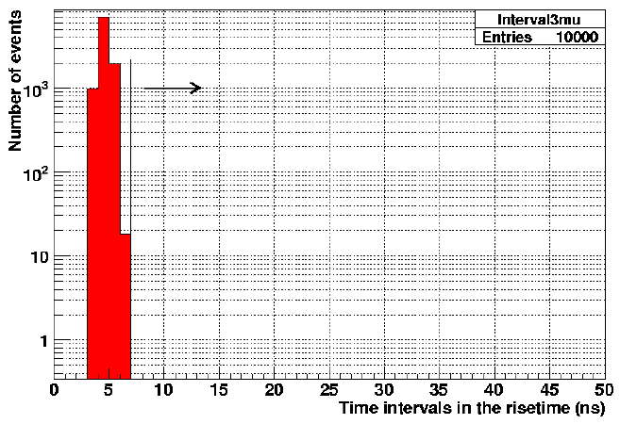
Proton Decay into K⁺ν
_
_
Signature p → K⁺ ν  μ⁺ν_{μ} / π⁰π⁺
coincidence: τ_{K} = 13 ns energy: 250-450 MeV modified by Fermi motion for ¹²C Background atmospheric ν‘s rejected by rise time cut: efficiency .67 hadronic channel: <1 per 1Mta (Kaon production) @ 4kmwe Current SK limit: 2.3x10³³ a
Limit for LENA if no event is observed in 10a (0.5Mta):
τ_{p} > 4x10³⁴ a (90%C.L.)
Proton decays
Atmospheric neutrinos
Michael Wurm, TUM Physics with LENA 13/24

Slide 15
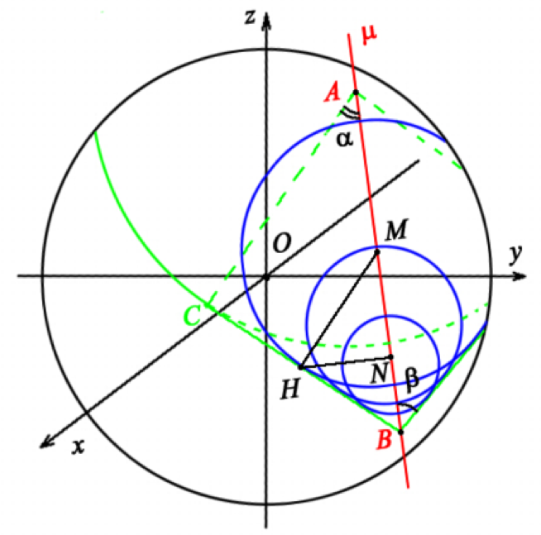
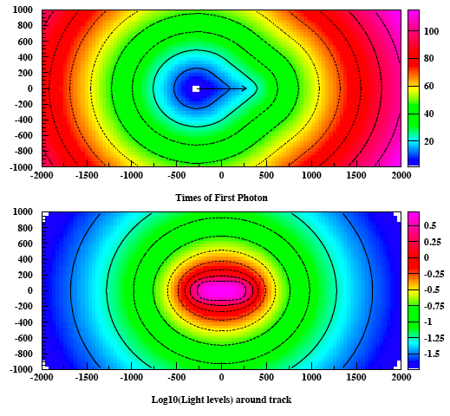
Tracking of Single Particles
HE particles create along their track a light front very similar to a Cherenkov cone.
Single track reconstruction based on:
Arrival times of 1st photons at PMTs
Number of photons per PMT
Sensitive to particle types due to the ratio of track length to visible energy.
Angular resolution of a few degrees, in principal very accurate energy resolution.
Considerable effort is also made in connection with the scintillator LBNE option for DUSEL -- J. Learned, N. Tolich ...

Slide 16
Resolution of HE Neutrino Events
CC events from HE ν‘s usually involve:
Quasi-elastic scattering E < 1 GeV
Single-pion production E = 1-2 GeV
Deep inelastic scattering E > 5 GeV
→ Resulting light front/PMT signals are superposition of single-particle tracks.
Multi-Particle Approach: (Juha Peltoniemi, arXiv:0909.4974)
Fit MC events with combinations of test particle tracks.
Single-event tracking as input.
Use full pulse-shape information of the individual PMTs to discern the particles.
Decay particles and capture processes (n‘s) provide additional information.
CC neutrino reaction cross-sections on Carbon, MiniBooNE, hep-ex/0408019

Slide 17
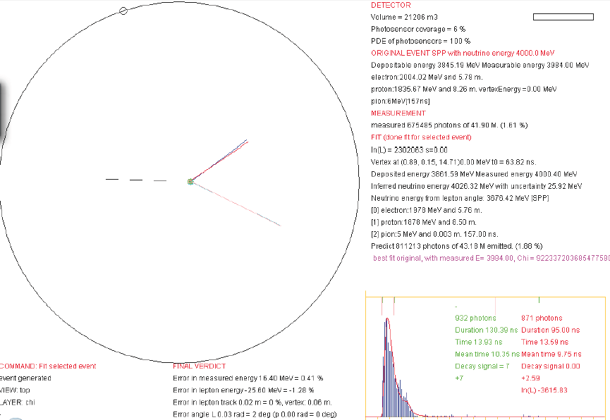
Monte Carlo Sample Event: ν_{e} Single-Pion Production
Neutrino energy: 4 GeV Error in measured energy: 0.4% Error in lepton energy: -1.3% Error in lepton track: Length: 0% Vertex: 0.06m Angle: 2°
Error in measured energy: 3.3% Error in lepton energy: 3.2% Error in lepton track: Length: 3% Vertex: 0.11m Angle: 0.01rad

Slide 18
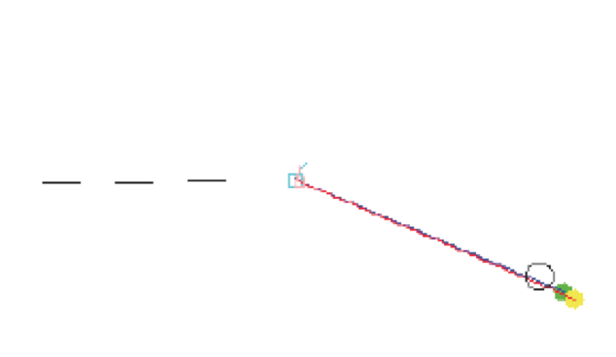
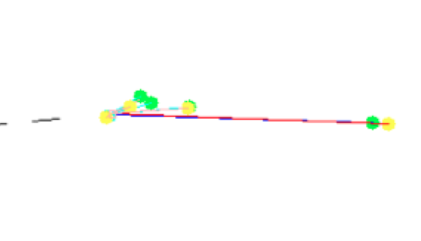
Tracking Performance
Single Tracks:
Flavor recognition almost absolute
Position resolution: few cms
Angular resolution: few degrees
Energy resolution: ca. 1% for 2-5 GeV range, depends on particle, read-out information
Multiparticle Events:
3 tracks are found if separated
more tracks very demanding
muon tracks always discernible
overall energy resolution: few %
track reconstruction less accurate
2GeV ν_{μ} quasielastic scattering
4GeV ν_{μ} deep-inelastic scattering
Michael Wurm, TUM Physics with LENA 17/24

Slide 19
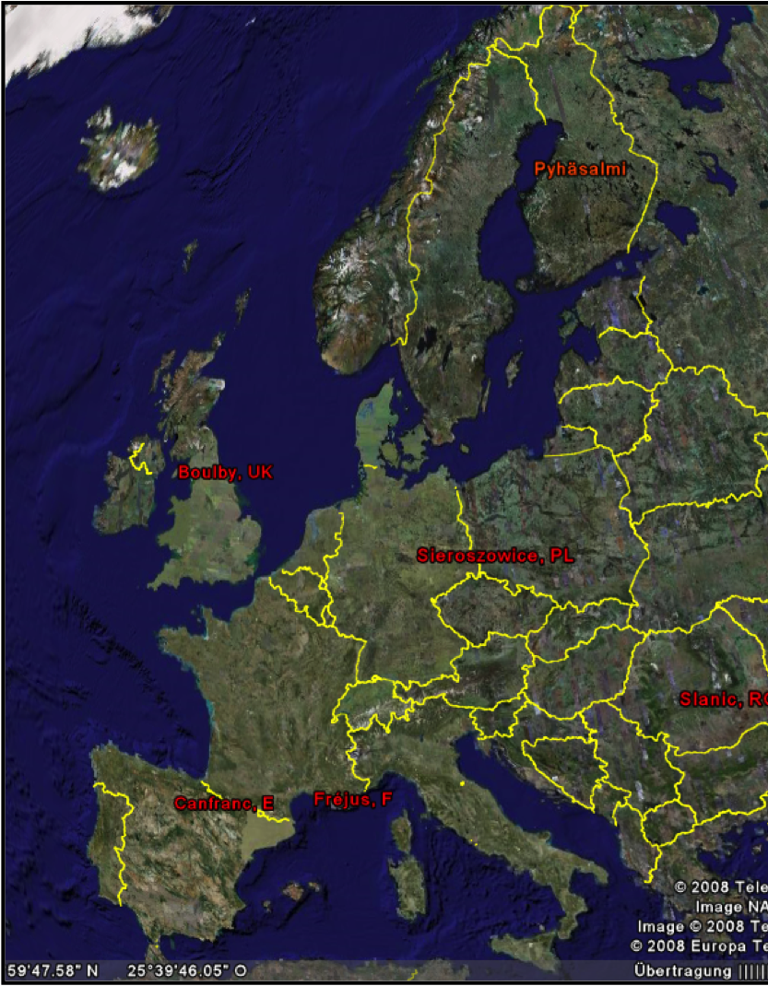
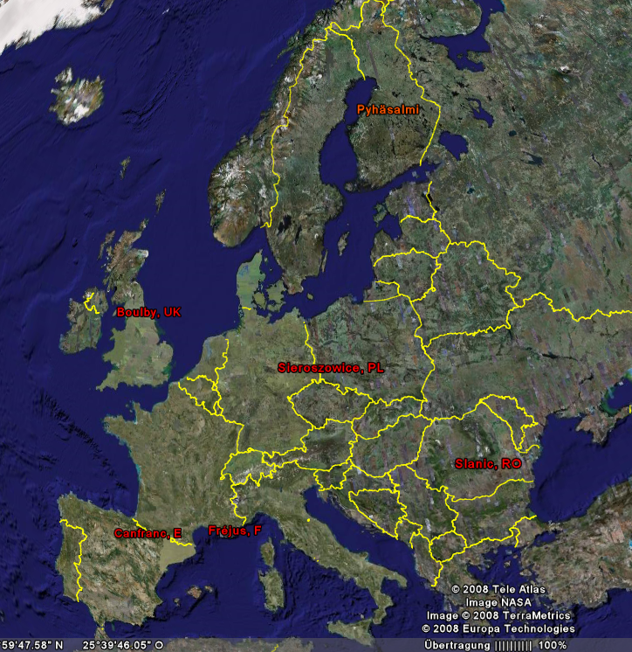
LENA as Long Baseline Detector
Baseline
CERN to Pyhäsalmi: 2288 km (>10³ km for mass hierarchy)
1st oscillation maximum 4 GeV
on-axis detector
Beam properties
wide band: energy 1-6 GeV
beam power: 3.3 x 10²⁰ pot/yr
5 yrs ν + 5 yrs ν
Preliminary GLoBES result
3σ sensitivity on θ₁₃, δ_{CP}, mass hierarchy for sin²(2θ₁₃)>5x10⁻³
[arXiv:0911.4876]
_
Michael Wurm, TUM Physics with LENA 18/24

Slide 20
What remains to be done?
Verification of tracking performance in GEANT4 MC. (e.g. light scattering, PM density, neutron tracking)
Evaluation of low-energy limit to directionality → proton decay into π⁰e⁺
Potential of atmospheric neutrino studies (from 50 MeV to 20 GeV)
Minimum hardware requirements: - PM (number, dynamic range, time jitter) - read-out electronics (FADCs?) - ...
Michael Wurm, TUM Physics with LENA 19/24

Slide 21
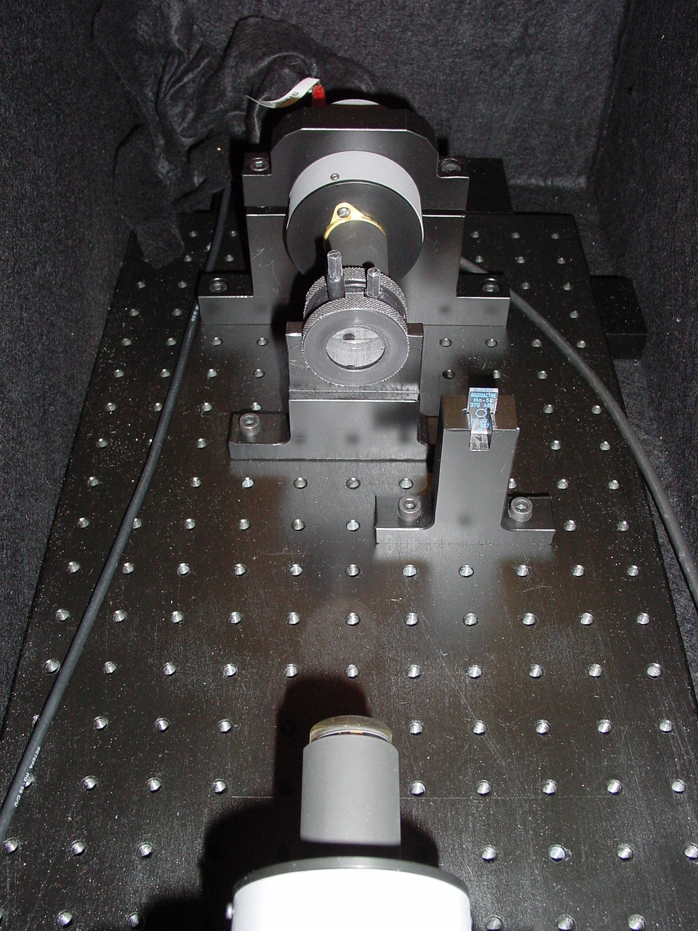
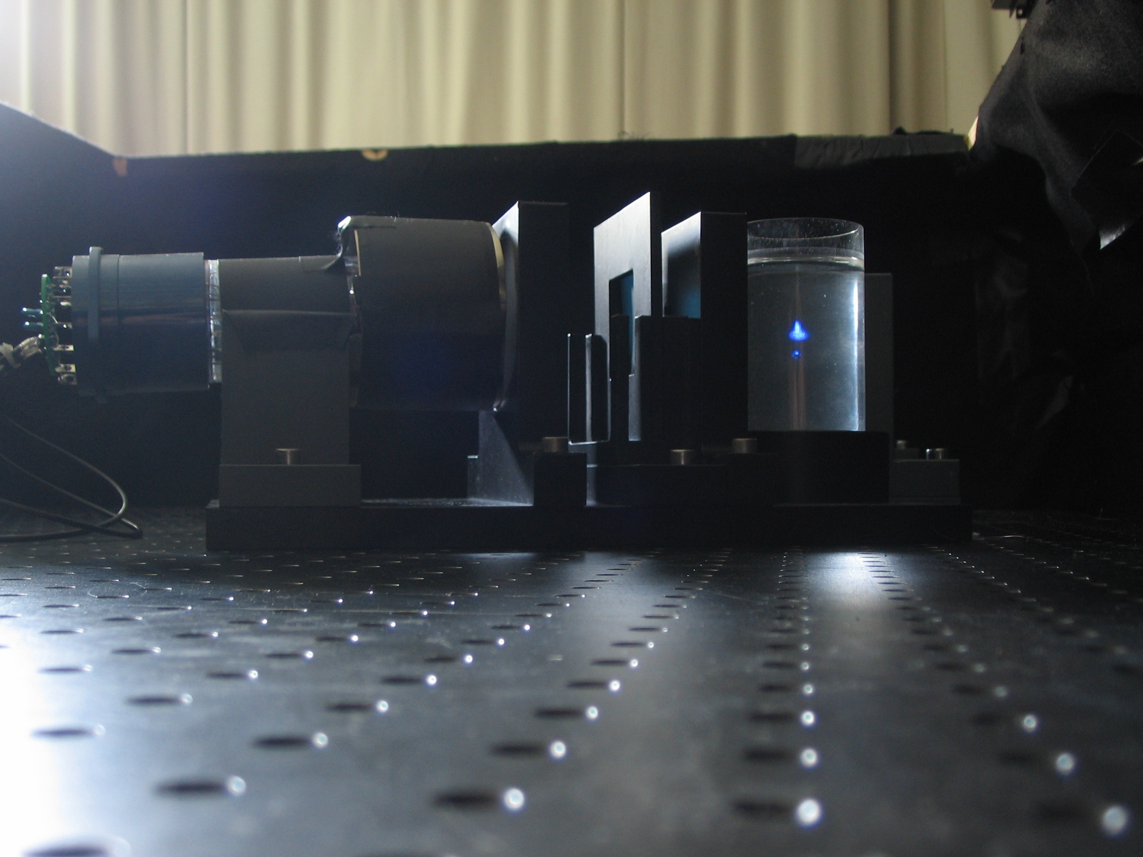
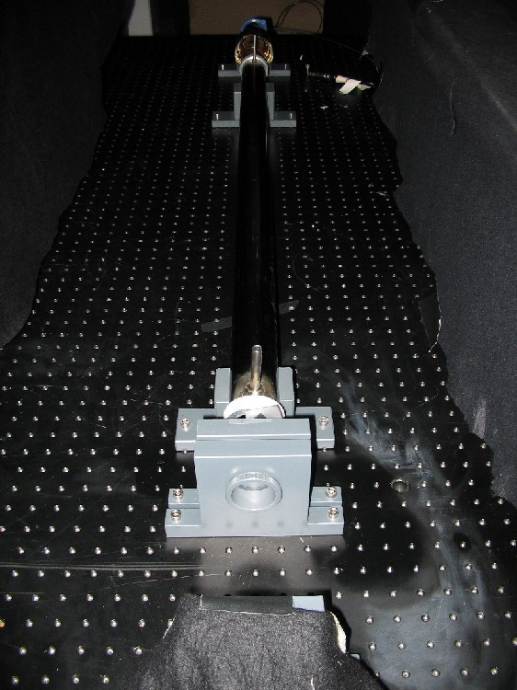
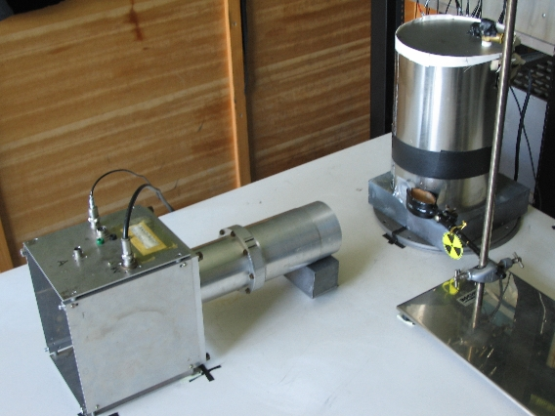
Scintillator R&D
fluorescence time & spectra
scattering length
attenuation length
light yield

Slide 22
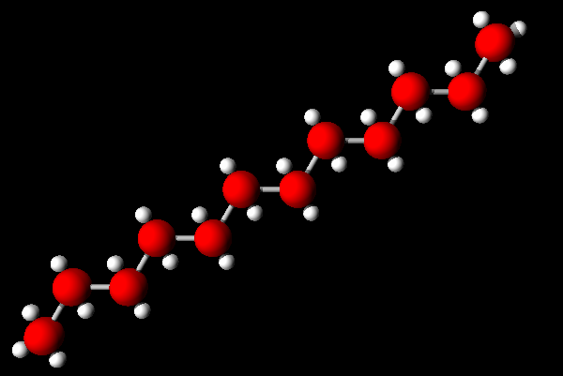
Solvent Candidates
LAB, C₁₆₋₁₉H₂₆₋₃₂
density: 0.86 kg/l
light yield: comparable
fluorescence decay: 5.2ns
attenuation length: <20m
scattering length: 25m
PXE, C₁₆H₁₈
density: 0.99 kg/l
light yield: ca. 10.000 ph/MeV
fluorescence decay: 2.6ns
attenuation length: ≤12m (purified)
scattering length: 23m
+80% Dodecane, C₁₂H₂₆
density: 0.80 kg/l
light yield: ca. 85%
fluorescence decay slower
attenuation length: >12m
scattering length: 33m
Detector diameter of 30m or more is well feasible!
Fluorescence times (3-5ns) and light yield (200-500pe/MeV) depend on the solvent.
LAB is currently favored.

Slide 23
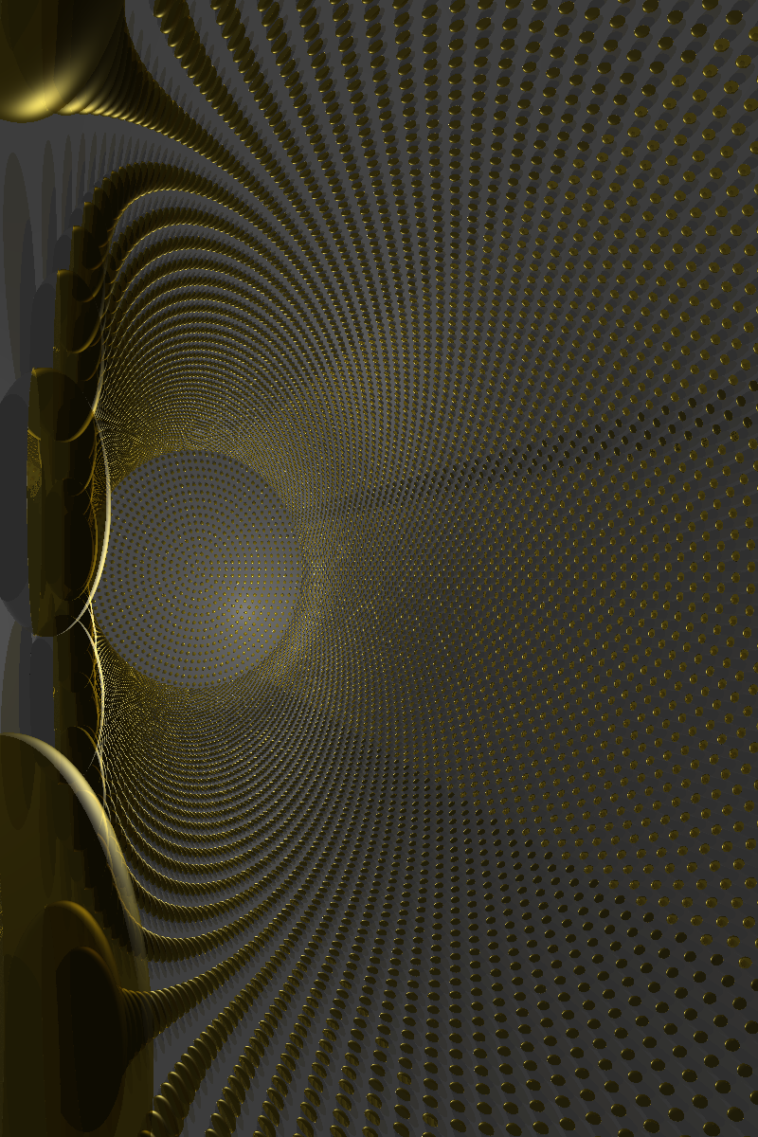
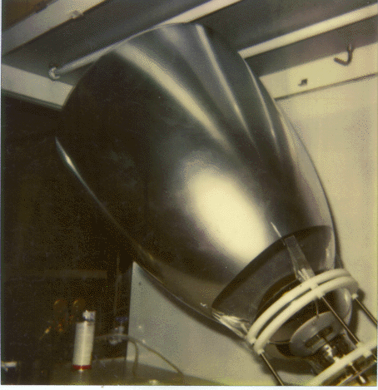
Light sensors
Default Configuration
13,500 PMs of 20‘‘ cathode diameter
optical coverage: 30%
Smaller Photomultipliers
machined PMs much cheaper
depends on cost per DAQ channel
Usage of Light Concentrators
Borex cones double optical coverage
Larger cones seem possible in LENA
Pressure resistance/encapsulation is needed for bottom PMTs (10 bar)
Light cone
used in the Borexino
prototype CTF

Slide 24
Summary
a large-volume liquid-scintillator detector like LENA is a multipurpose neutrino observatory
very rare event search as well as high-statistics measurements of (astrophysical) sources
track reconstruction at GeV energies opens up the possibility for neutrino beam physics and atmospheric neutrino detection
work on liquid scintillator mostly completed, optimization of PM configuration on-going
Michael Wurm, TUM Physics with LENA 23/24

Slide 25
Bibliography
J. Peltoniemi, Simulations of neutrino oscillations for a wide band beam from CERN to LENA, arXiv:0911.4876 (2009)
J. Peltoniemi, Liquid scintillator as tracking detector for high-energy events, arXiv:0909.4974 (2009)
T. Marrodan Undagoitia et al., Fluorescence decay-time constants in organic liquid scintillators, Rev. Sci. Instr. 80 (2009) 043301, arXiv:0908.0616
H. O. Back et al., Borexino collaboration, Phenylxylylethane (PXE): a high-density, high-flashpoint organic liquid scintillator for applications in low-energy particle and astrophysics experiments, Nucl. Instrum. Meth. A 585 (2008) 48, physics/0408032
D. Autiero et al., Large underground, liquid based detectors for astro-particle physics in Europe: scientic case and prospects, J. Cosm. Astrop. Phys. 0711 (2007) 011, arXiv:0705.0116
M. Wurm et al., Detection potential for the diffuse supernova neutrino background in the large liquid-scintillator detector LENA, Phys. Rev. D 75, 023007 (2007), astro-ph/ 0701305
T. Marrodan Undagoitia et al., Search for the proton decay p->K+antineutrino in the large liquid scintillator detector LENA, hep-ph/0511230
K. A. Hochmuth et al., Probing the Earth's interior with a large-volume liquid scintillator detector, Astrop. Phys. 27 (2007) 21-29, hep-ph/0509136
Michael Wurm, TUM Physics with LENA 24/24

Slide 26
Backup Slides
Michael Wurm, TUM Physics with LENA 25/24

Slide 27
Sensitivity to CP-Violating Phase
3σ discovery potential
2σ
1σ
preliminary
Michael Wurm, TUM LAGUNA in Boulby, 9.12. 10/17

Slide 28
Sensitivity to Mixing Angle θ₁₃
preliminary
Michael Wurm, TUM LAGUNA in Boulby, 9.12. 11/17

Slide 29
Sensitivity to Mass Hierarchy
preliminary
Michael Wurm, TUM LAGUNA in Boulby, 9.12. 12/17

Slide 30
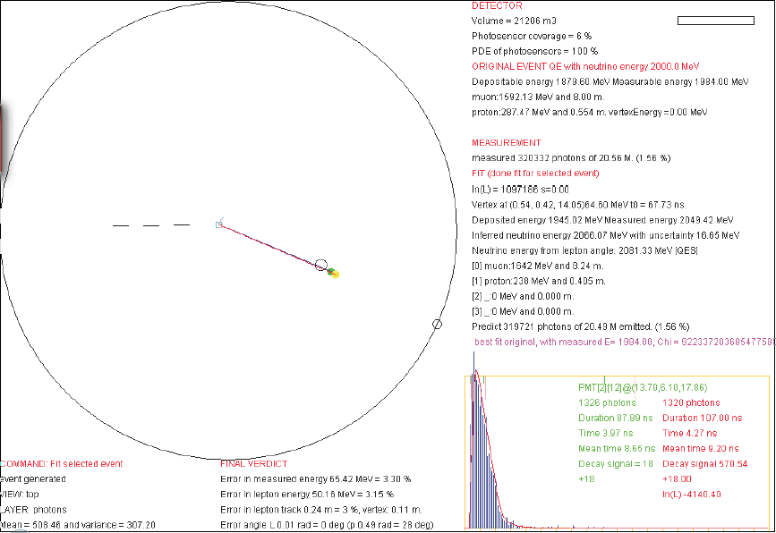
Scinderella Sample Event: ν_{μ} Quasi-Elastic Scattering
Error in measured energy: 3.3% Error in lepton energy: 3.2% Error in lepton track: Length: 3% Vertex: 0.11m Angle: 0.6°

Slide 31
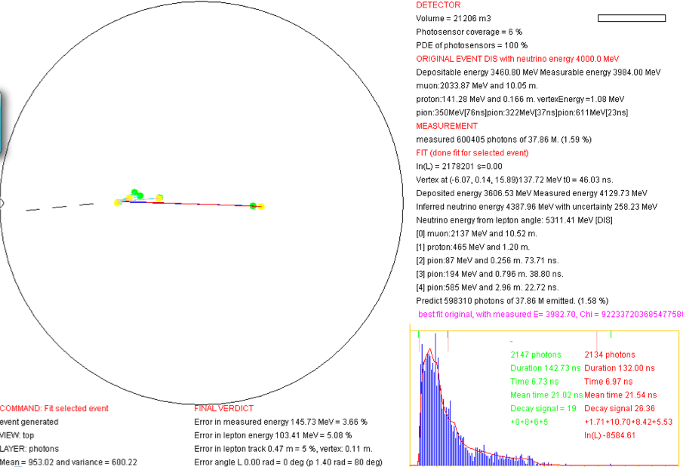
Scinderella Sample Event: ν_{μ} Multi-Pion Deep Inelastic Scattering
Error in measured energy: 3.6% Error in lepton energy: 5% Error in lepton track: Length: 5% Vertex: 0.11m Angle: 0.00rad

Slide 32
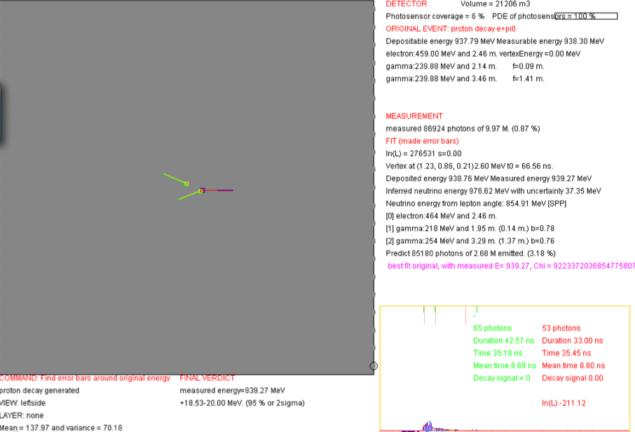
Scinderella Sample Event: Proton Decay into π⁰e⁺

Slide 33
Preliminary Results
3σ sensitivity on θ₁₃, δ_{CP}, mass hierarchy for sin²(2θ₁₃)>5x10⁻³
Detector Size: 50 kt very good, 100 kt would be better
Energy resolution of about 3% fully sufficient, resolution better than 5% will not improve results
Vertical orientation is small disadvantage (<10% reduction in target mass)
Baseline of >1200 km needed for mass hierarchy
Improved background rejection not important, beam contamination is the bottle-neck
Michael Wurm, TUM Physics with LENA 32/24

