Slide 1


DANSS - detector of the reactor antineutrino
(status report)
V.Egorov (DLNP JINR, Dubna)

Slide 2
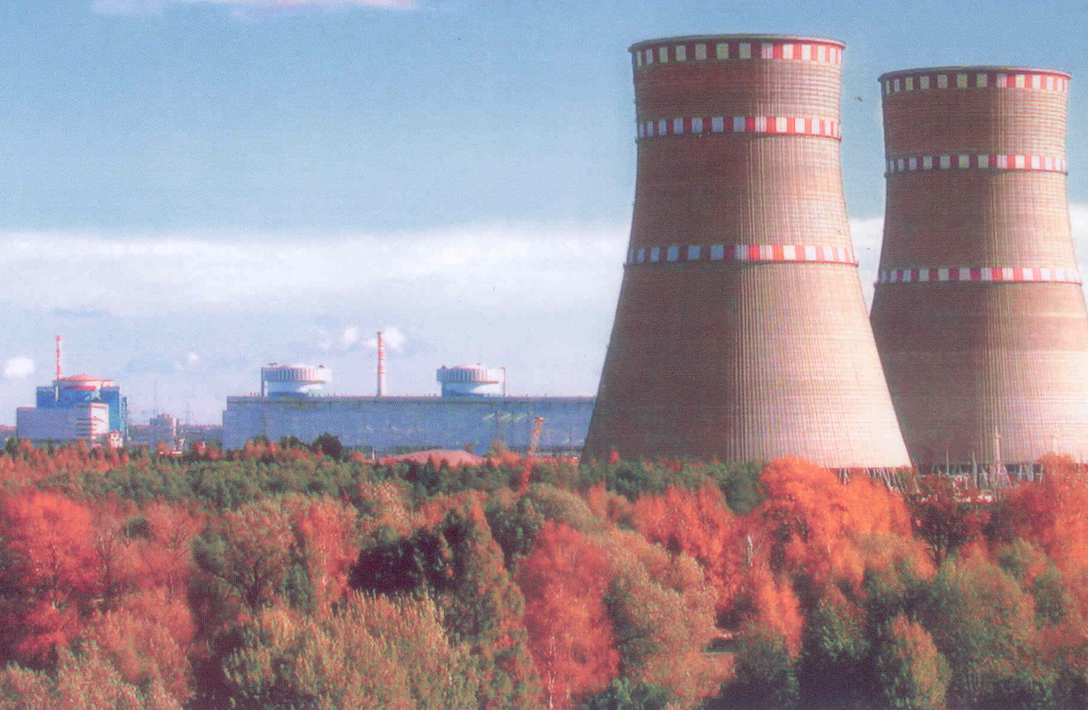
GEMMA experiment: search for the NMM
Since 2005 we do NMM measurements under the unit #2 of the KNPP – a standard 3GW_{th} PWR (ВВЭР-1000)
Life-time ~ 320 days
1500 kg of ²³⁵U is burned out
and 311 kg of ²³⁹Pu is produced
which changes the flux and energy spectrum of the neutrino emitted
Would like to monitor the neutrino spectrum and flux (2.7∙10¹³ ν/cm²/s)

Slide 3
For the monitoring we needed anything simple and reliable

Slide 4
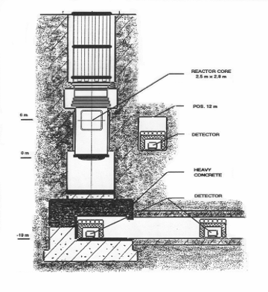
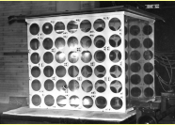
20 years ago our colleagues from KI were the first who tried to perform the neutrino monitoring
RONS (Rovno, UA) 1986-1990
Liquid scintillator (~1 m³)
in a special laboratory

Slide 5
Counts per 100 000 sec
The group of
L.А. Mikhaelyan (КI):
Rovno NPP (UA) 1986-1990
Reactor operation after the fuel refilling
Days

Slide 6
Relative changes in the heutrino spectrum:
1 – N_{ν}(actual) / N_{ν}(initial)
Neutrino energy [MeV]

Slide 7
We want such detector!
«We» – means JINR (Dubna)
+
ITEP (Moscow)

Slide 8
Which kind of detector ?
Generally ~1 m³ of liquid scintillator is used
RONS (SU), NUCIFER (FR), ANGRA (BR), SONGS1 (US), KASKA (JP)
☹ But: we have no experience in LS
☹ But: they say it is problematic (Gd…)
☹ But: is there any SANE DIRECTOR of NPP who allows to bring 1 ton of gasoline close to his reactor ?!
☺ How much better is plastic scintillator !..

Slide 9
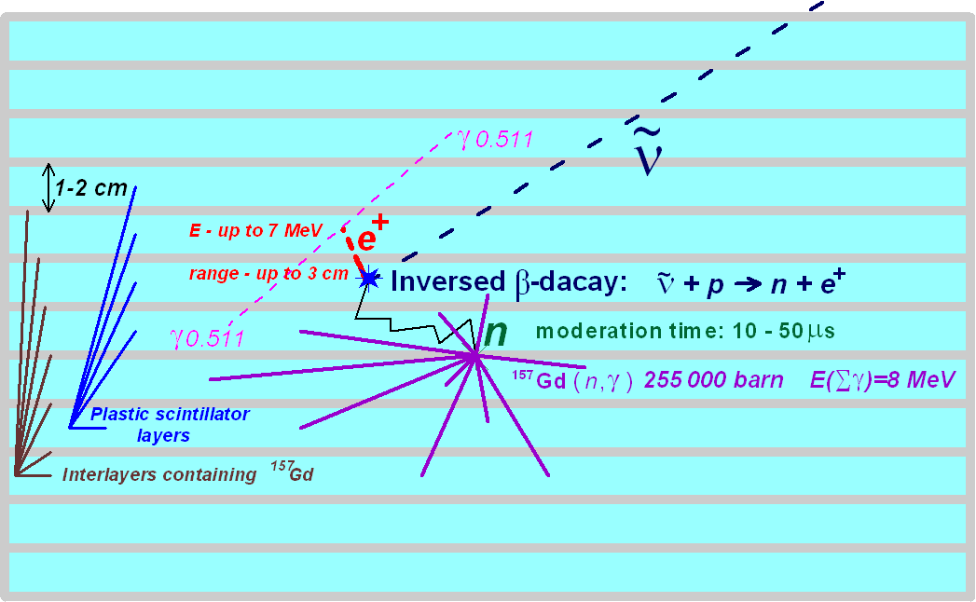
Detection idea: Inversed Beta-Decay

Slide 10
Signature of the IBD registration
(from 2.6)
to 8 MeV
e⁺
(n,γ)
Local burst
The burst
spread in space
30-50 μs

Slide 11

Detection of the reactor neutrino would allow:
Measure the actual reactor power (N_{ν})
Deduce the actual fuel composition (E_{ν})
Weak (ν-e) cross-section
On-line reactor monitoring (tomography?) – especially important in view of the future FBR (with longer life-time and less studied)
Non-proliferation (prevent unauthorized extraction of ²³⁹Pu)

Slide 12
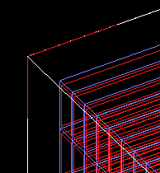
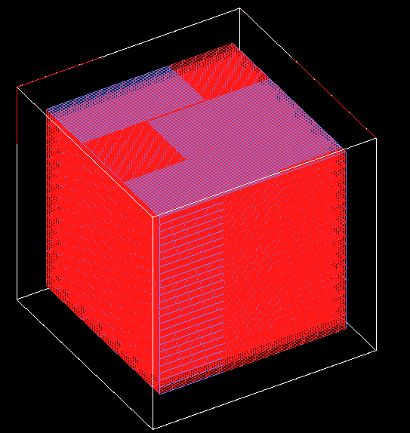
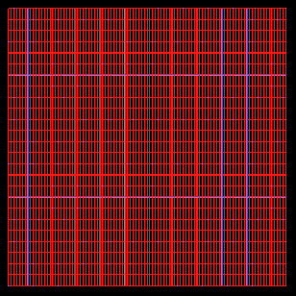
# geometry of neutrino detector
# SCINTILLATOR BLOCKS
# in X axis
bottom-scinblock.number-of-columns=100
# in Y axis
bottom-scinblock.number-of-rows=25
# in X axis
bottom-scinblock.width=1 cm
# in Y axis
bottom-scinblock.length=4 cm
# in Z axis
bottom-scinblock.thickness=1 m
# material of capturer layer on the scintillator surface
# available materials: Gadolimium Cadmium
bottom-scinblock.n-capt.material=Cadmium
# thickness of capturer layer on the X surface
bottom-scinblock.n-capt.x-thickness = 150 micrometer
# thickness of capturer layer on the Y surface
bottom-scinblock.n-capt.y-thickness = 300 micrometer
10³ MC-simulations
10⁶ experimental tests
As a result:
conception
of the spectrometer
XY-view
# NEUDET CHAMBER
# global X size
chamber.width = 1.2 m
# global Y size
chamber.length = 1.2 m
# global Z size
chamber.thickness = 1.2 m
SC
Layer of
N-capturer
(Gd,Cd,...)
XY-view

Slide 13
Plast. scnt.
(µ-shield)
CH₂ + B
(n-shield)
Pb
(γ-shield)
Segmental solid plastic scintillator (2500 cells)
Sensitive
volume=1 m³
Cu (carriage frames =
γ-shield)
S³
S-cube
DANSS

Slide 14
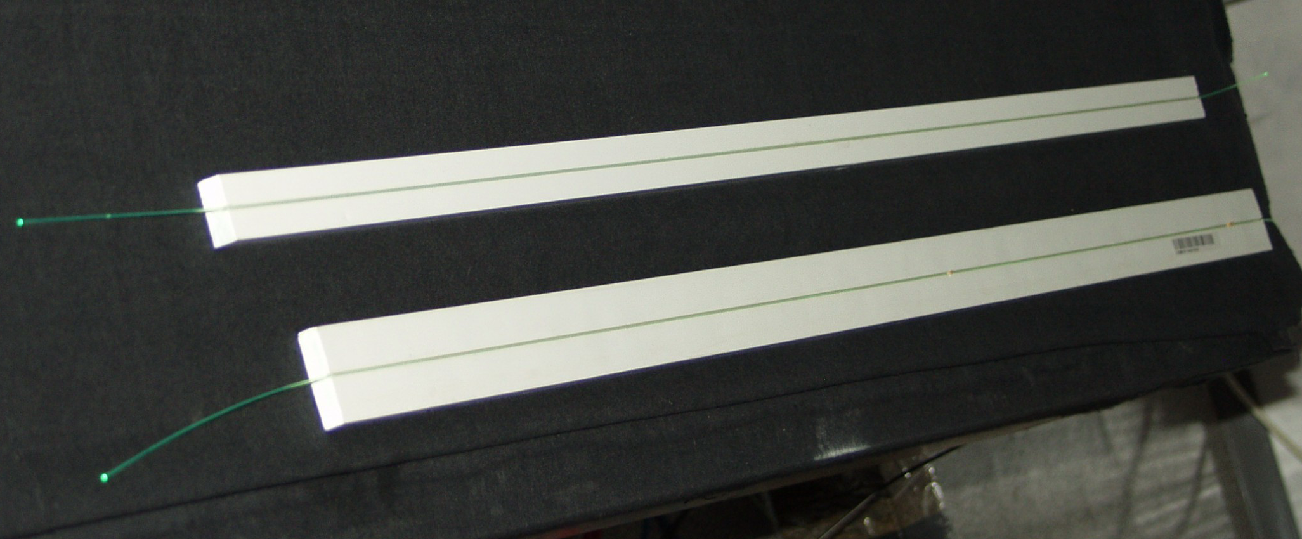
Basic element –
- scintillator cell (“strip” )
Gd-containing
light-reflecting
coating
3 wave-length shifting (WLS) fibers Ø1.2 mm
Polystyrene-based scintillator

Slide 15
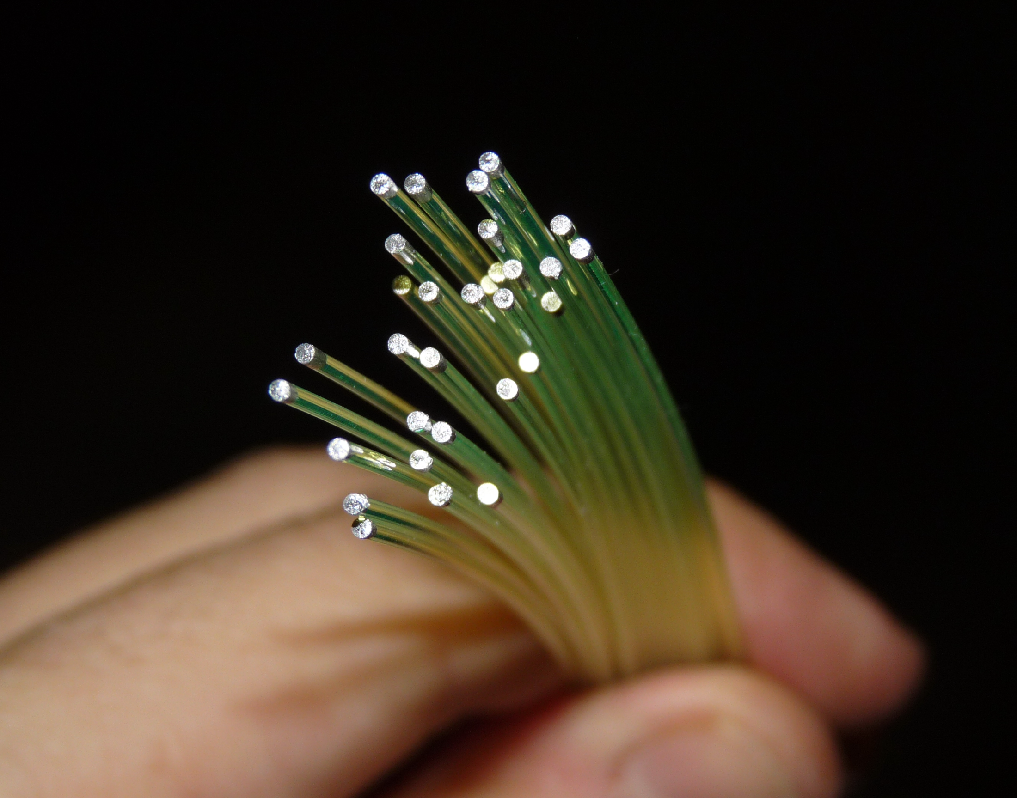
Blind end of each WLS-fiber is coated (chemically) with light reflector

Slide 16
Modular structure of the detector
A number of strips are combined into intercrossing X- and Y-modules.

Slide 17
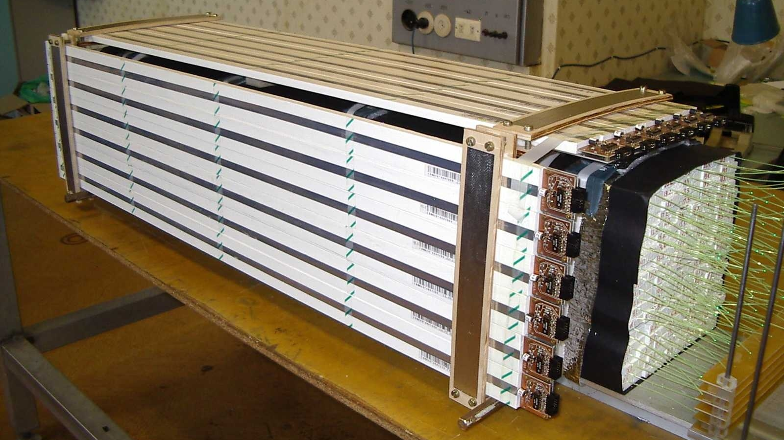
Prototype: 2 parallel modules (no Gd-coating)

Slide 18
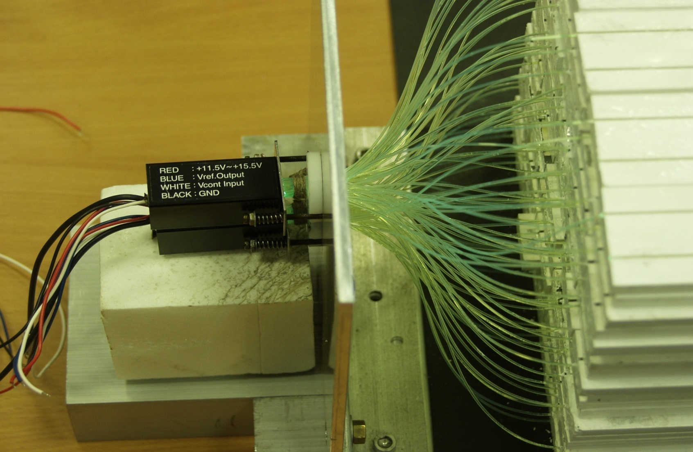
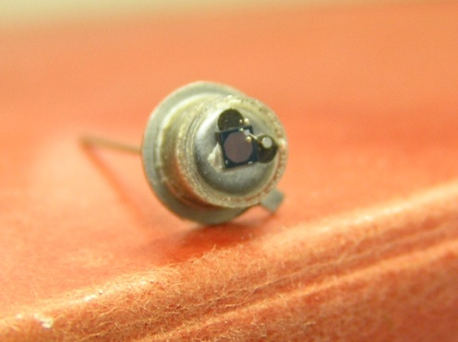
Light collection
One PMT per Module (25-50 strips):
measure total energy of the photon burst
produce “hard trigger”
Individual photo-diod (SiPM or MPPC) per each strip:
space distribution of the photon burst
pixel
Al
hν
R 50Ω
base
U

Slide 19
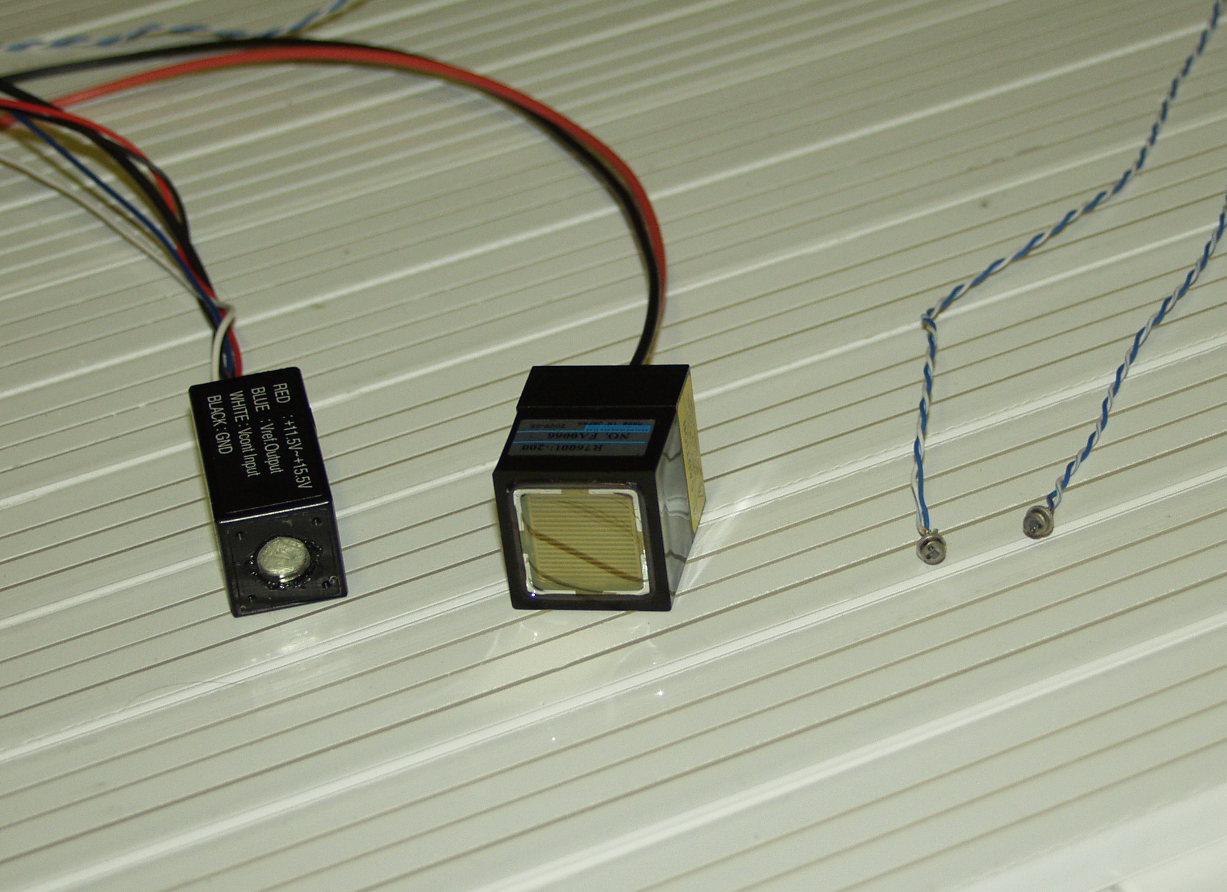
PMT+HV
(Japan)
PMT
(Japan)
MPPC (Russia)

Slide 20
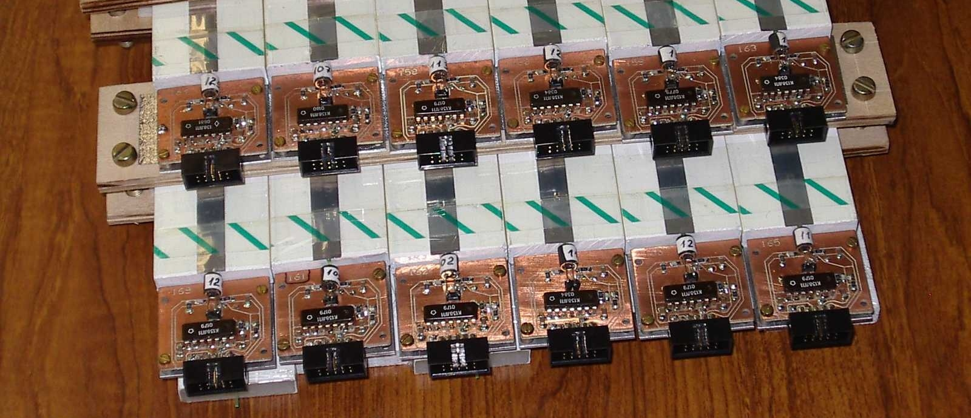
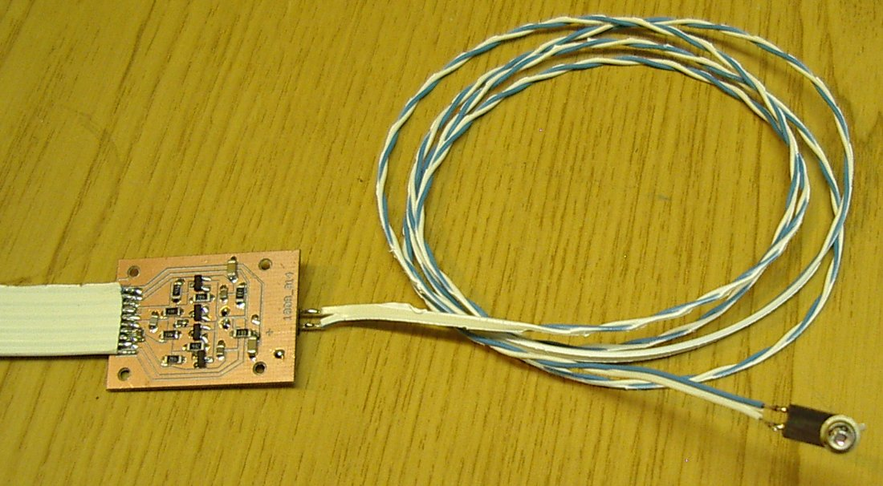
MPPC preamplifiers

Slide 21
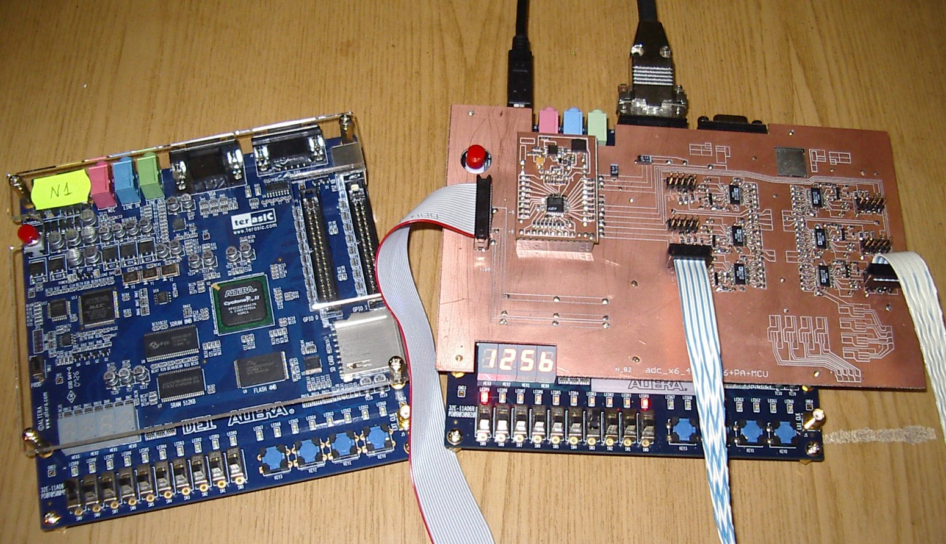
Flash ADC etc.

Slide 22
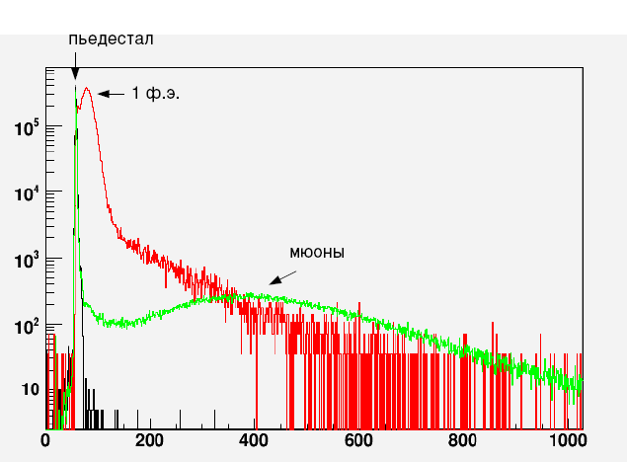
μ
&
ADC gate
ADC input
Typical
energy
spectrum
Light sensor
(H6780, etc.)
pedestal
Single photo-electron peak
Test bench for strips,
WLS-fibers and photo sensors
Cosmic
muons
ADC-channels

Slide 23
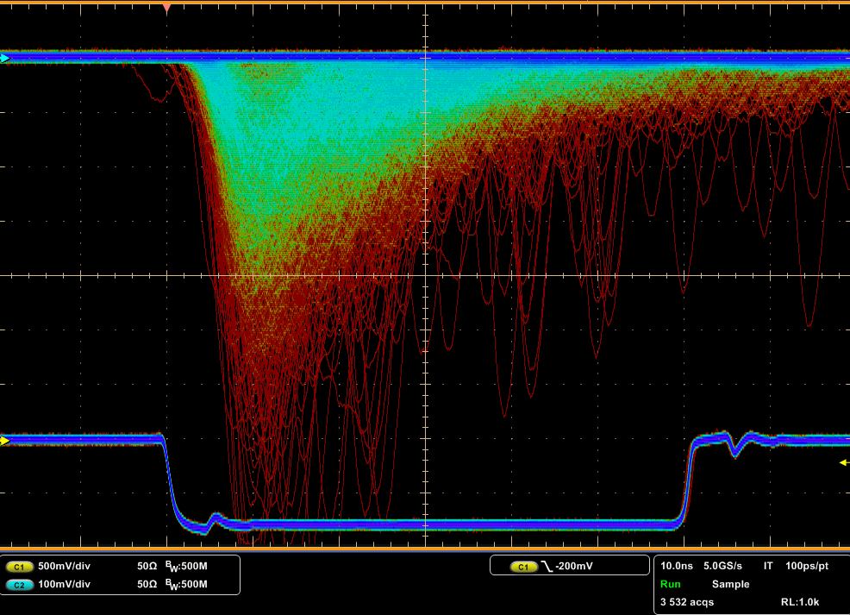

Slide 24
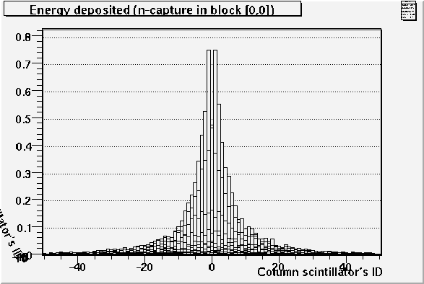
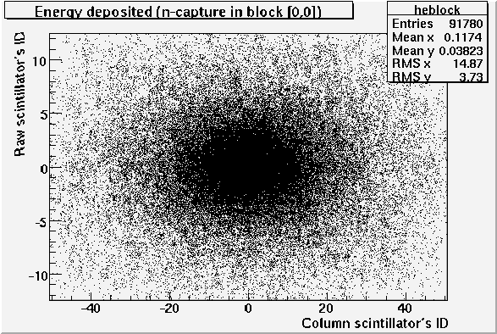
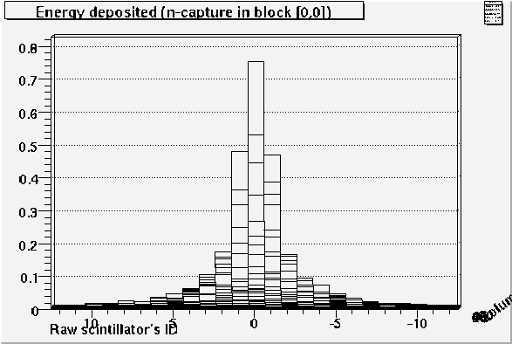
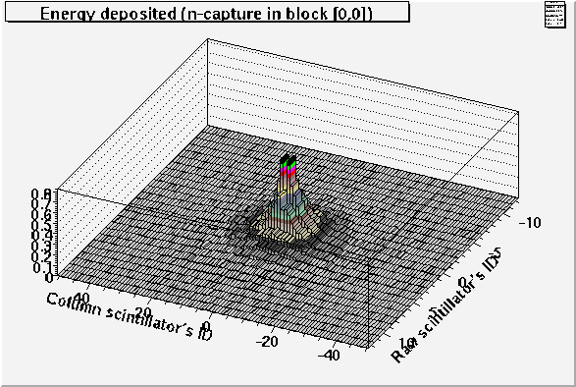
Monte Carlo simulations
Example:
Space distribution of the energy deposit after the ¹⁵⁷Gd(n,) reaction

Slide 25
Start the real creation!
End of 2009:
Enough of R&D.

Slide 26
Carriage frames

Slide 27
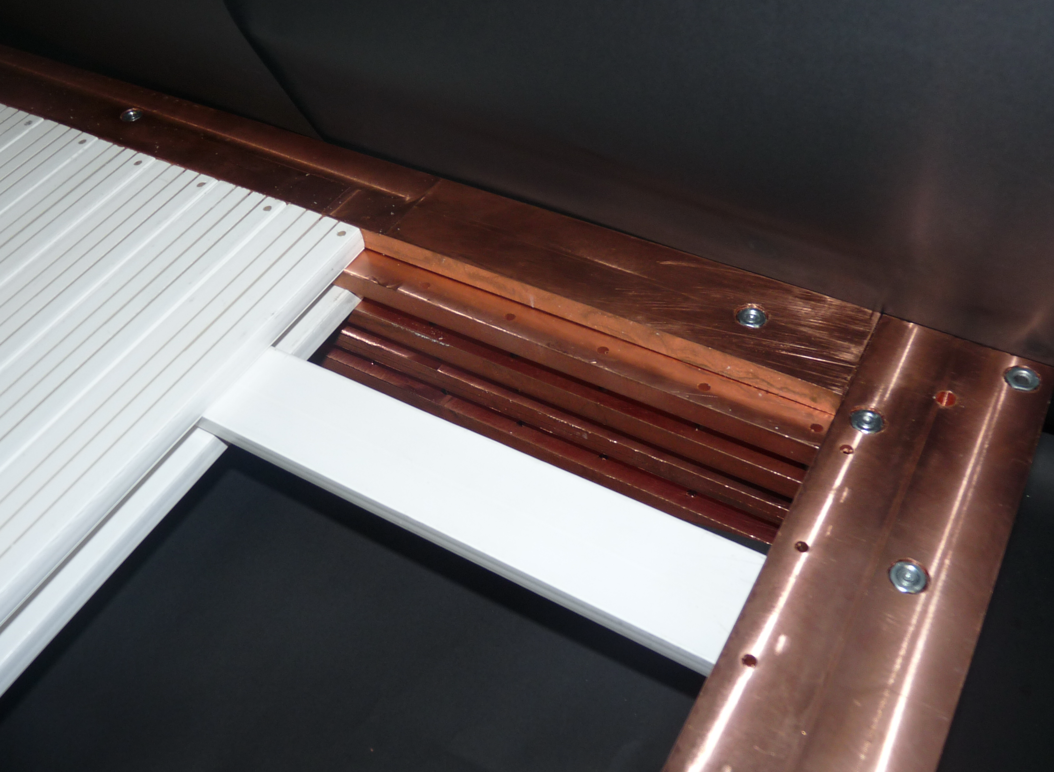

Slide 28
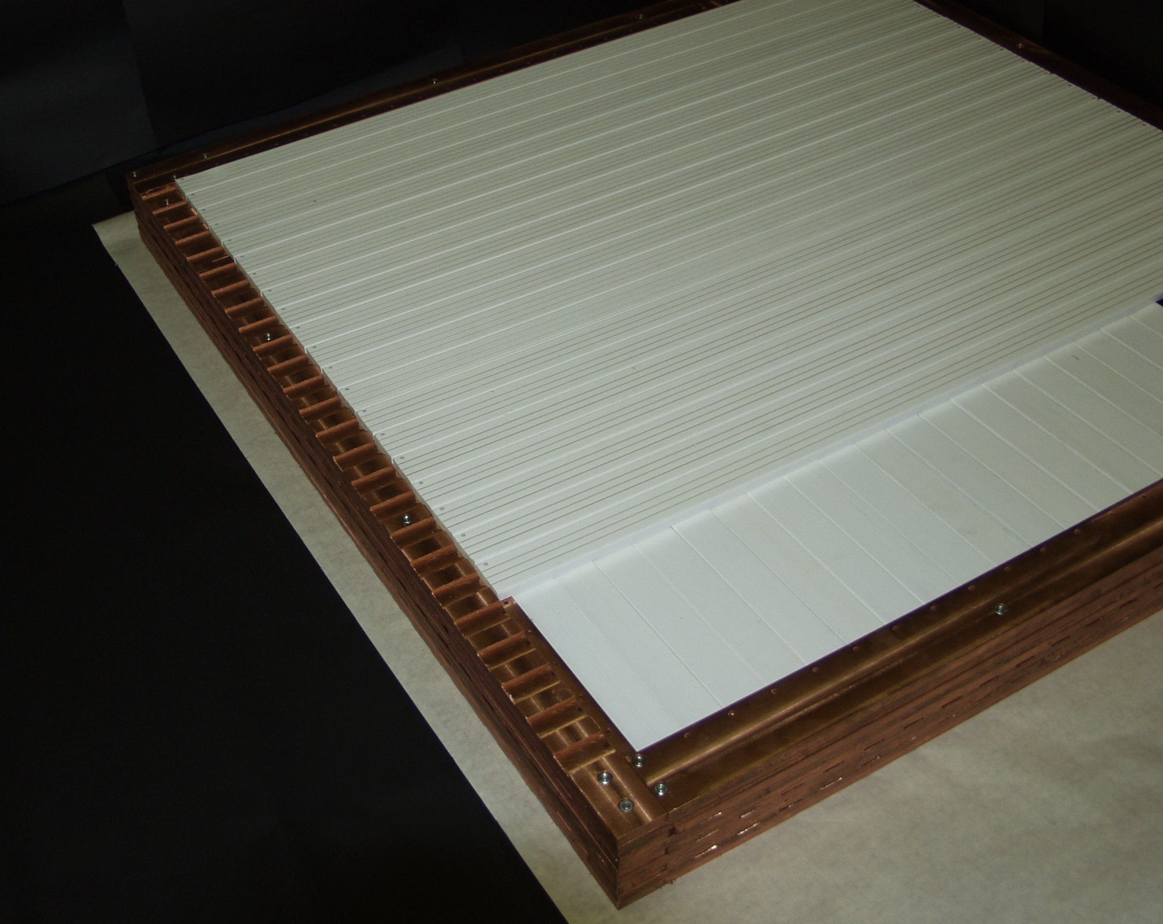

Slide 29
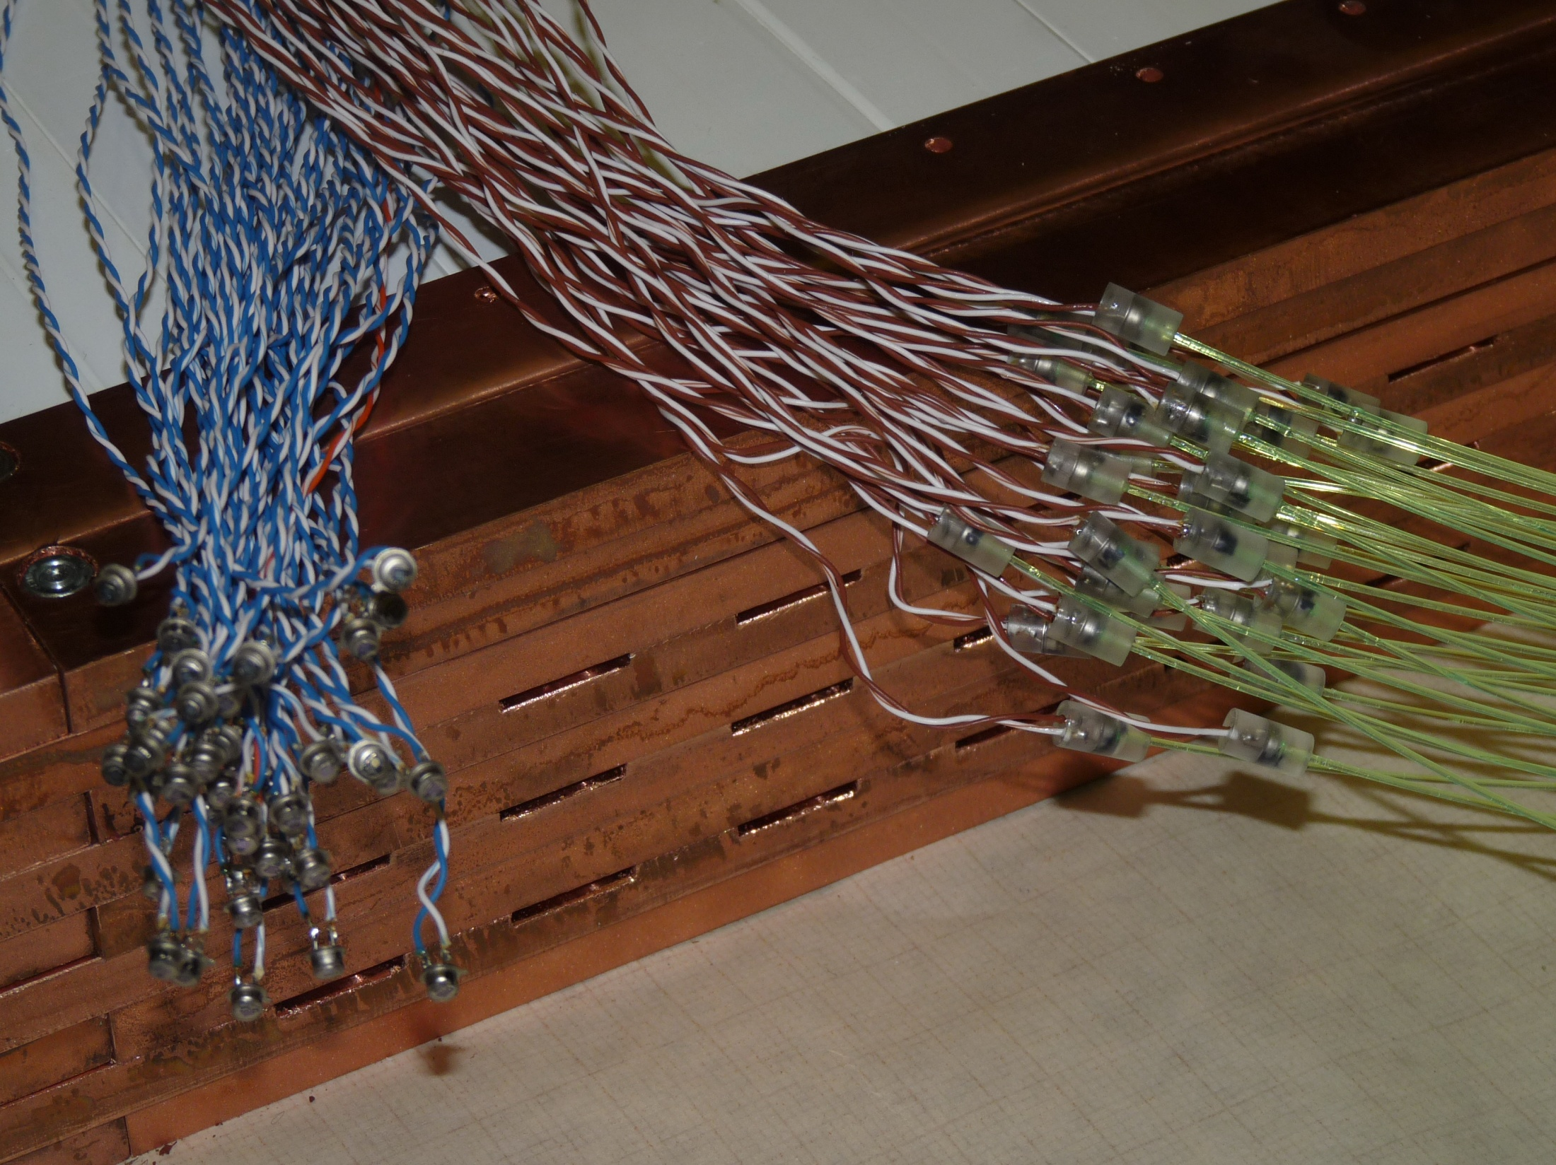

Slide 30
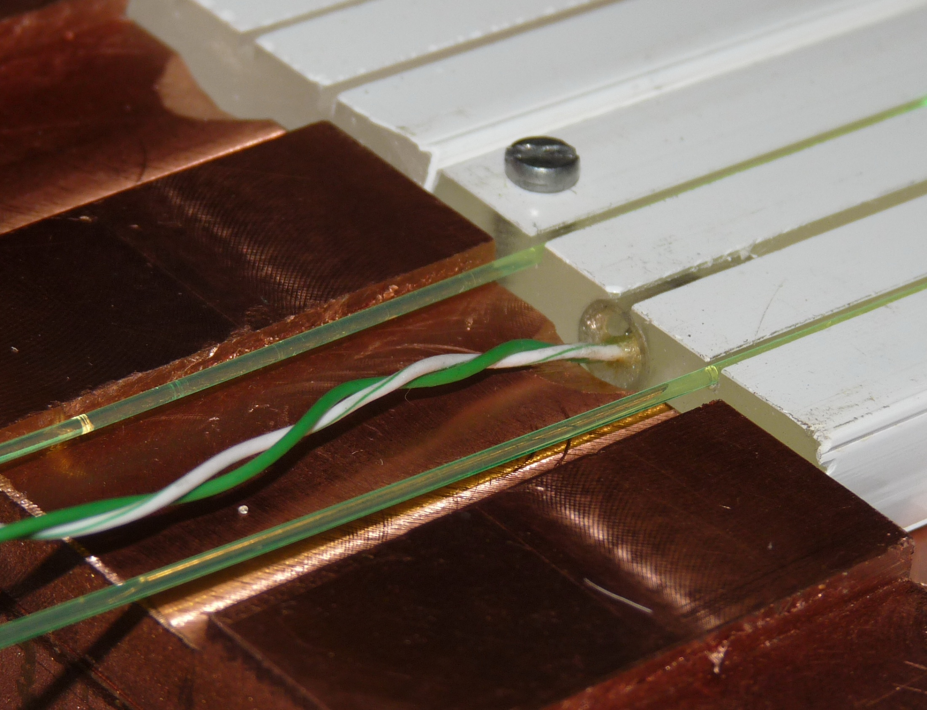
MPPC
Twisted pair (to PA)
2 fibes to PMT

Slide 31
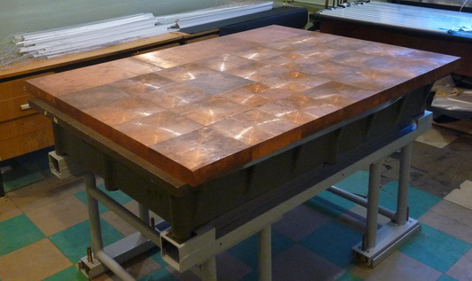
Mounting table
(with Cu bottom shielding)

Slide 32
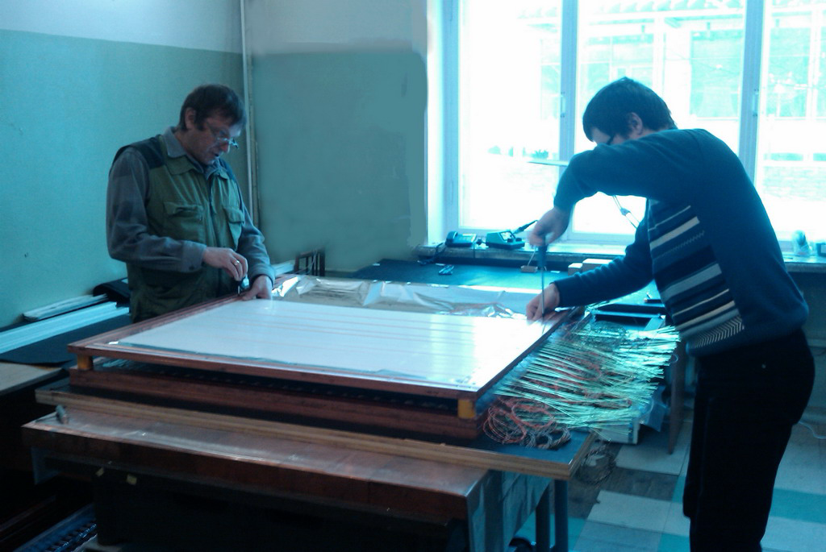
Mounting of the first section

Slide 33
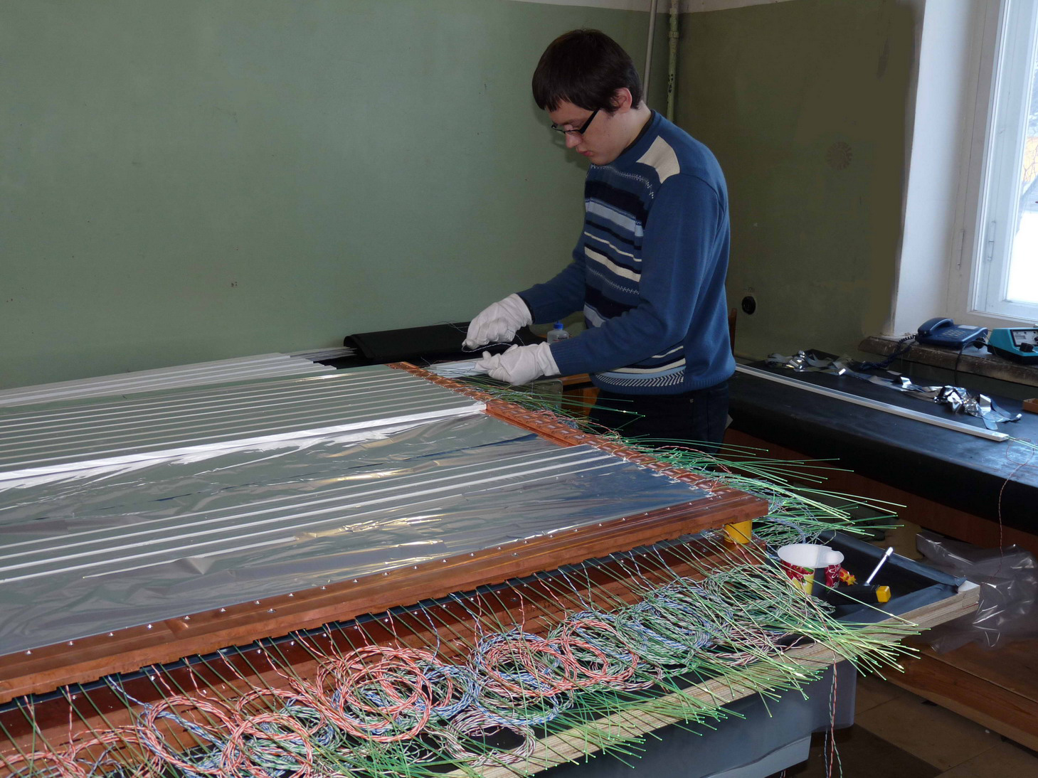

Slide 34
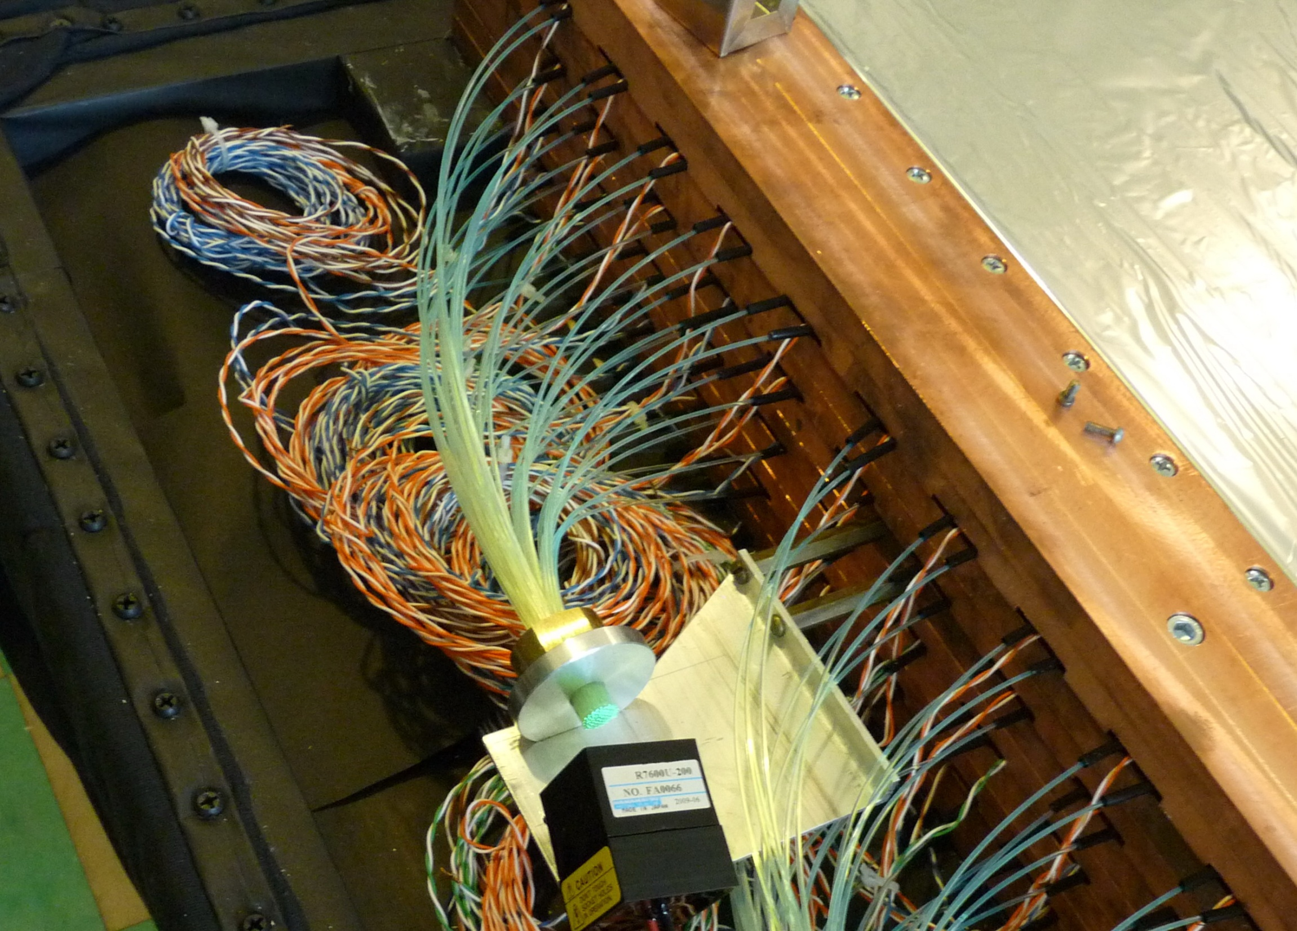

Slide 35
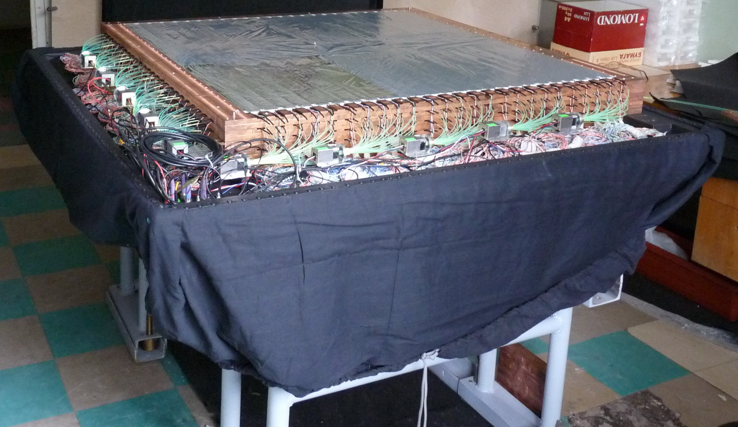

Slide 36
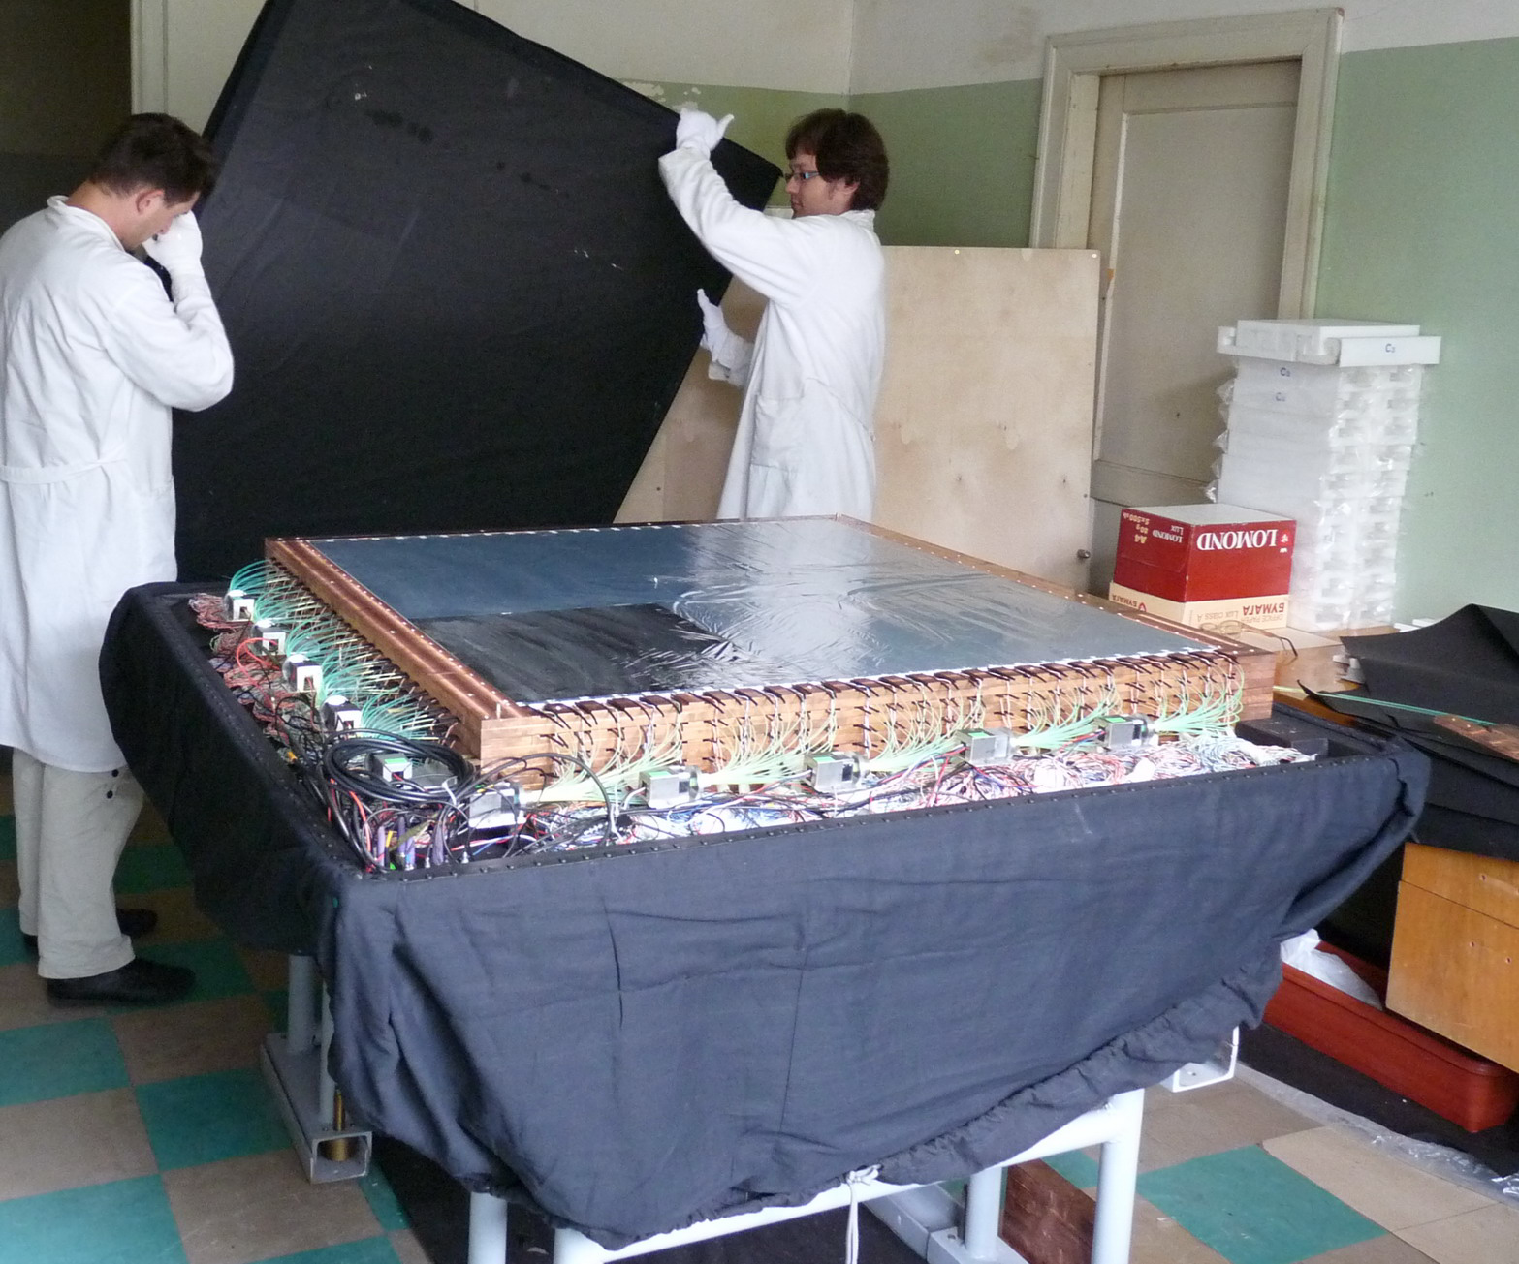

Slide 37
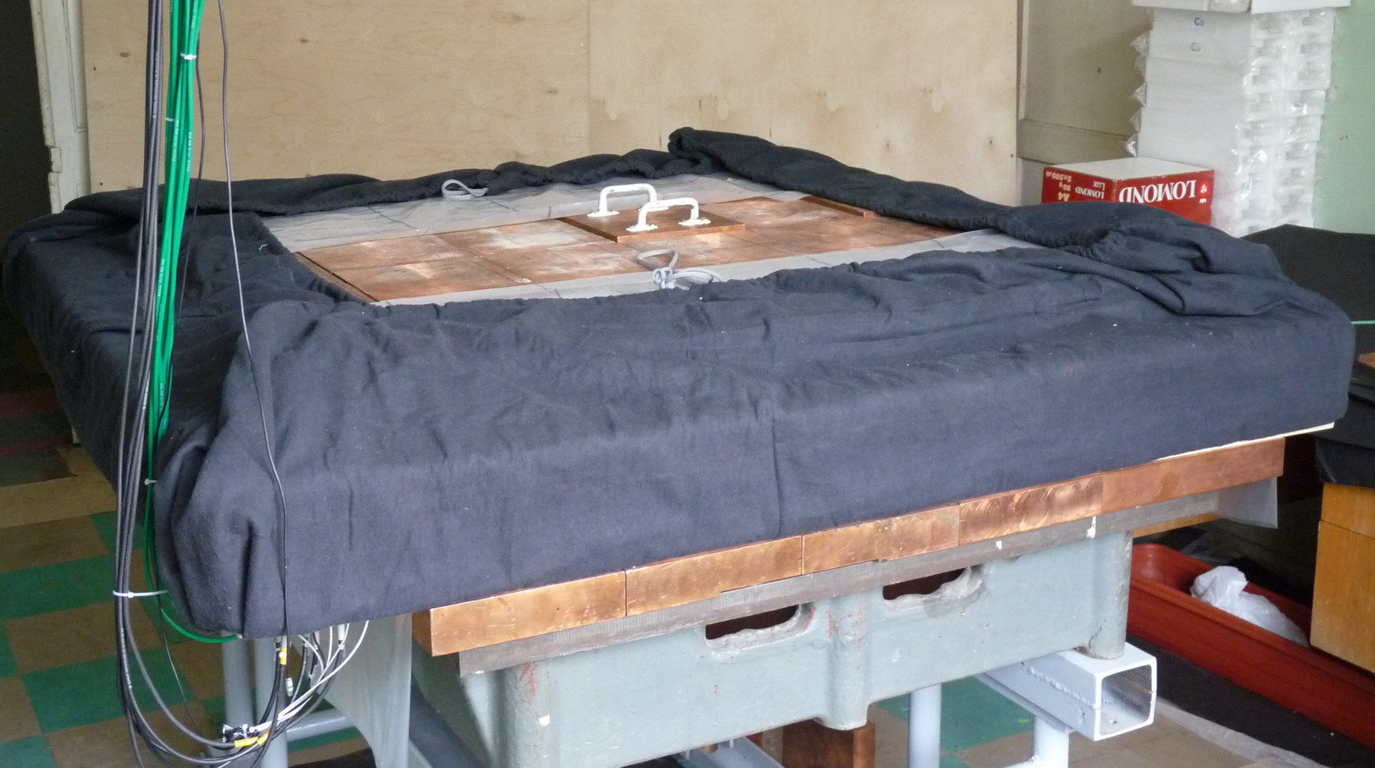

Slide 38
The section #0 was dismounted and sent to Moscow (our ITEP-members of the team are playing with it now).
After some corrections we have started production of the sections #1, #2, etc.

Slide 39
The GEMMA-1 site:
Reactor unit #2 of the
“Kalinin” Nuclear Power Plant
(400 km North from Moscow)
Overburden
(reactor, building, shielding, etc.):
~70 m of W.E.
Technological room
just under reactor
14 m only!
2.7×10¹³ ν/cm²/s

Slide 40
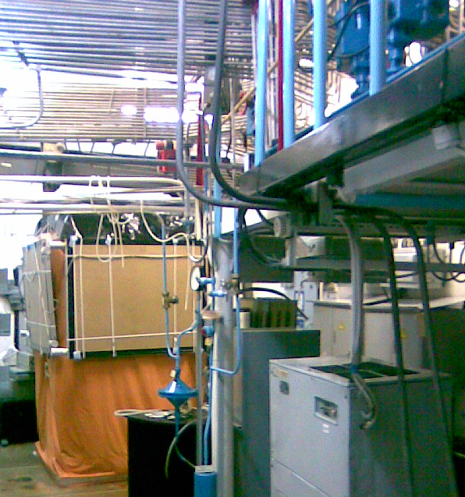
GEMMA background conditions
γ-rays were measu- red with Ge detector. The main sources are: ¹³⁷Cs , ⁶⁰Co, ¹³⁴Cs.
Neutron background was measured with ³He counters, i.e., thermal neutrons were counted. Their flux at the facility site turned out to be 30 times lower than in the outside laboratory room.
Charged component of the cosmic radiation (muons) was measu-red to be 5 times lower than outside.

Slide 41
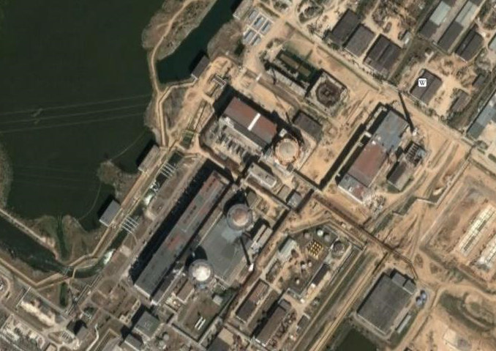
To be started on Sept. 2011
КАЭС
s
i
t
e
a
v
a
i
l
a
b
l
e
14 →10 m
5∙10¹³ ν/cm²/s

Slide 42
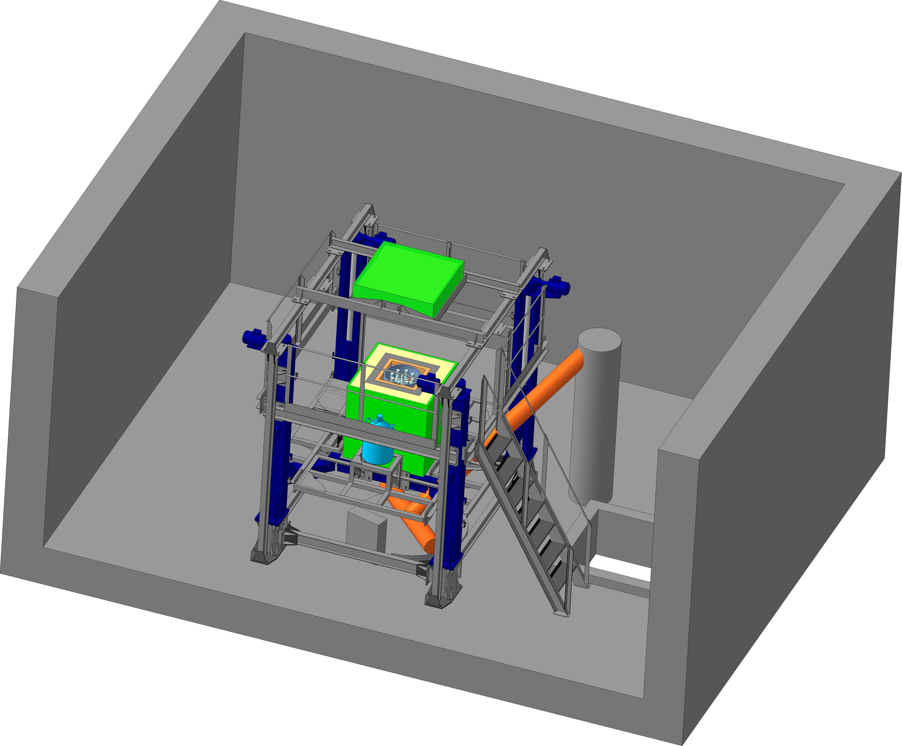

Slide 43
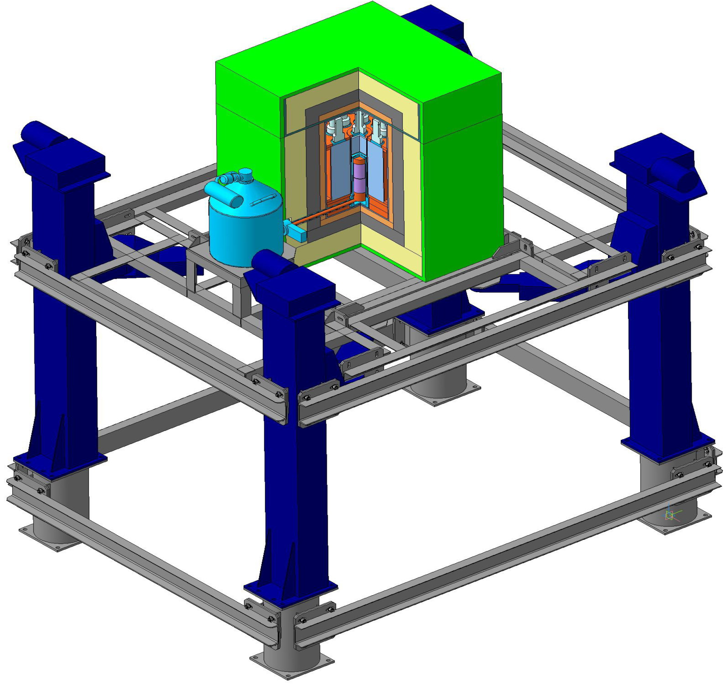
^{GEMMA-2}
Lifting
mechanism

Slide 44
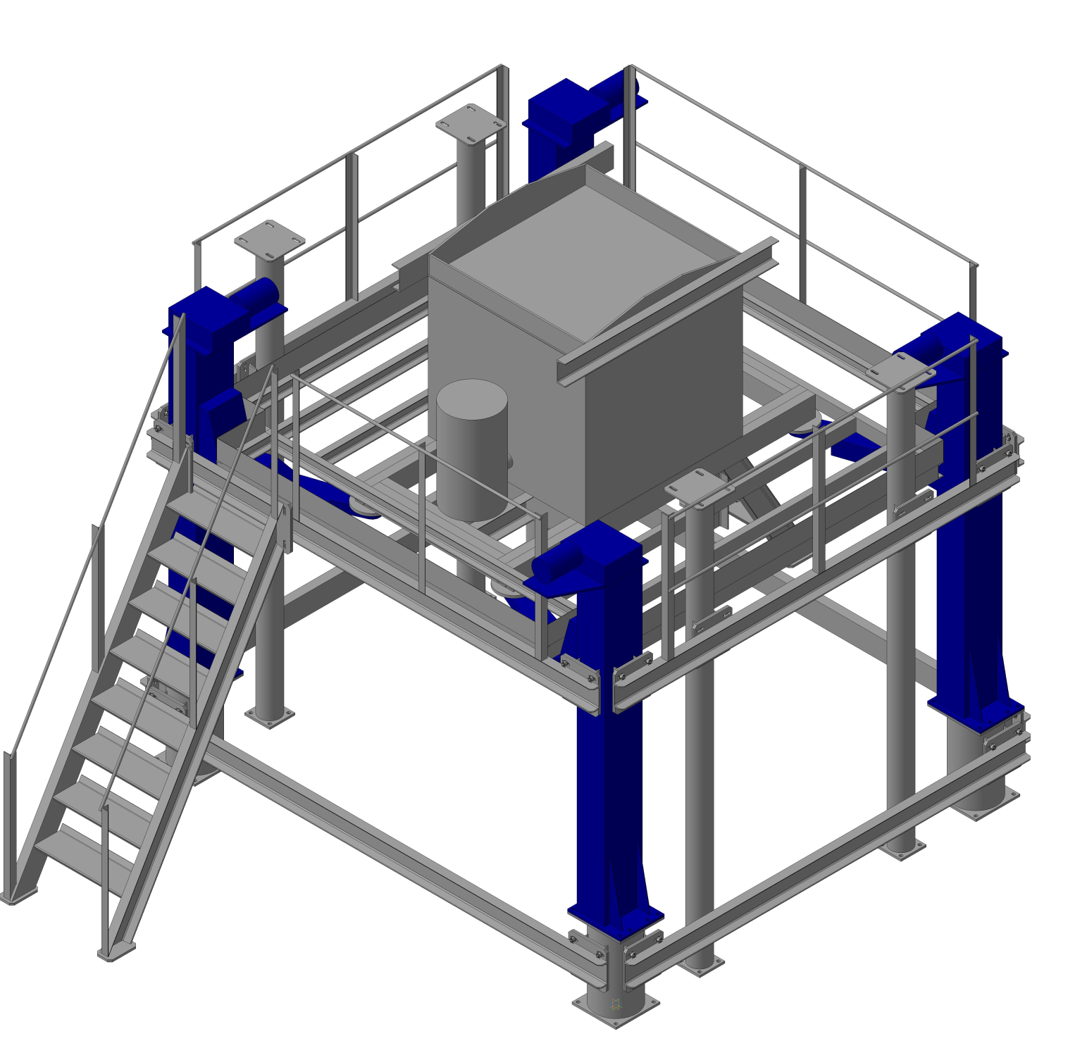
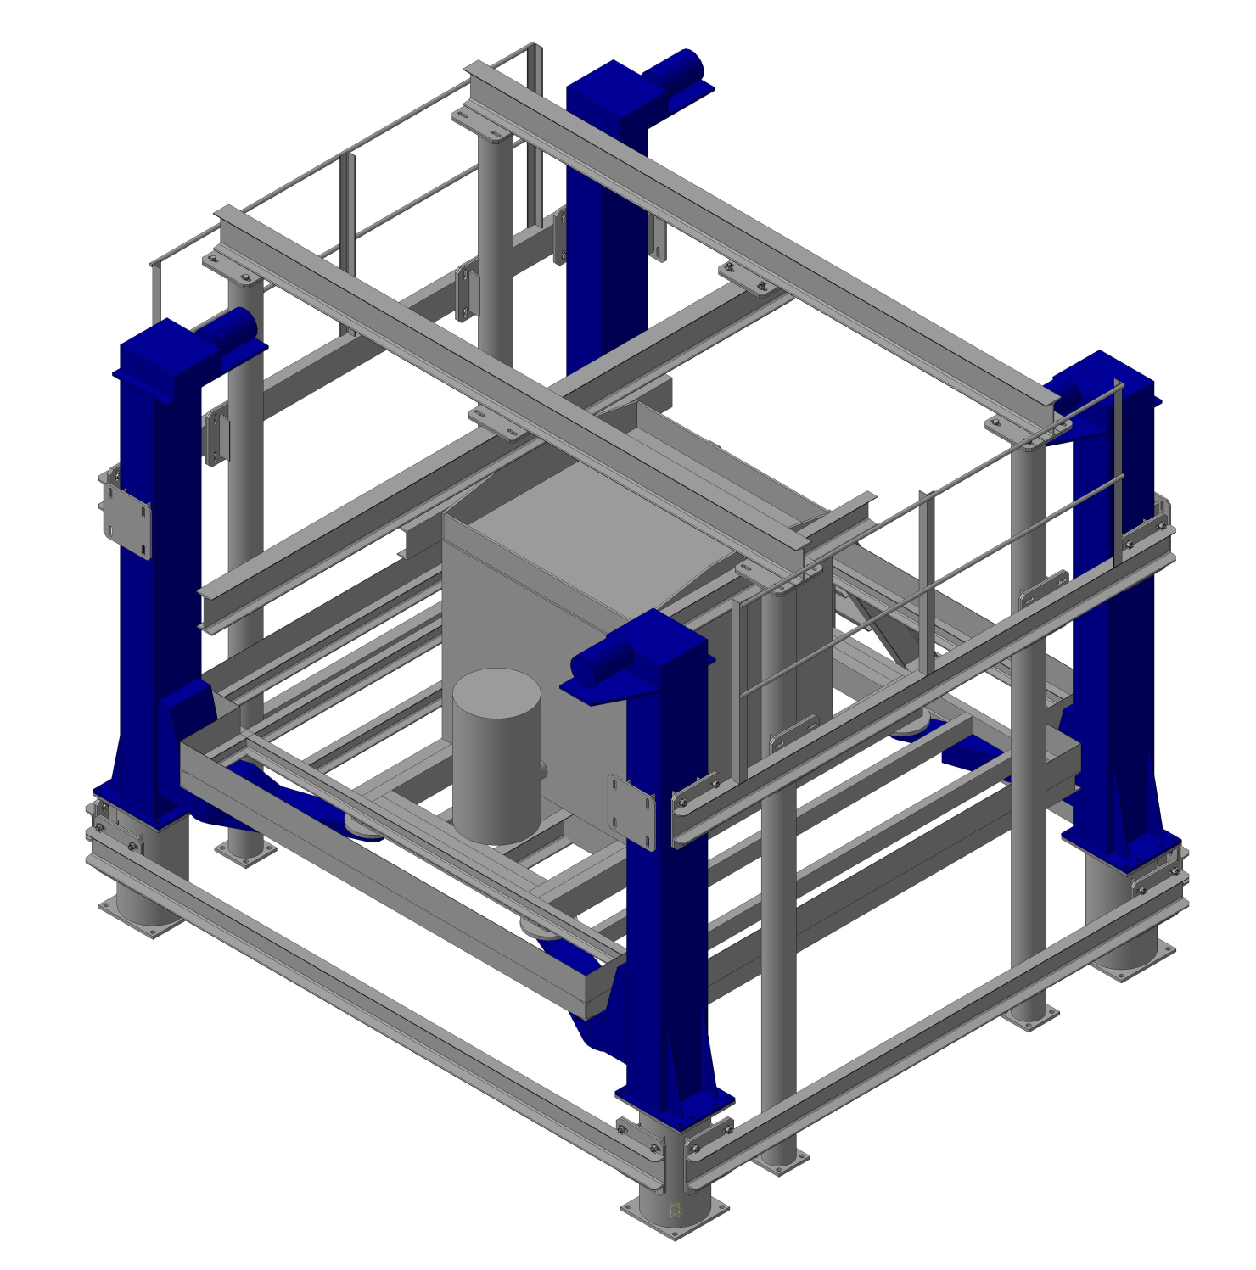

Slide 45
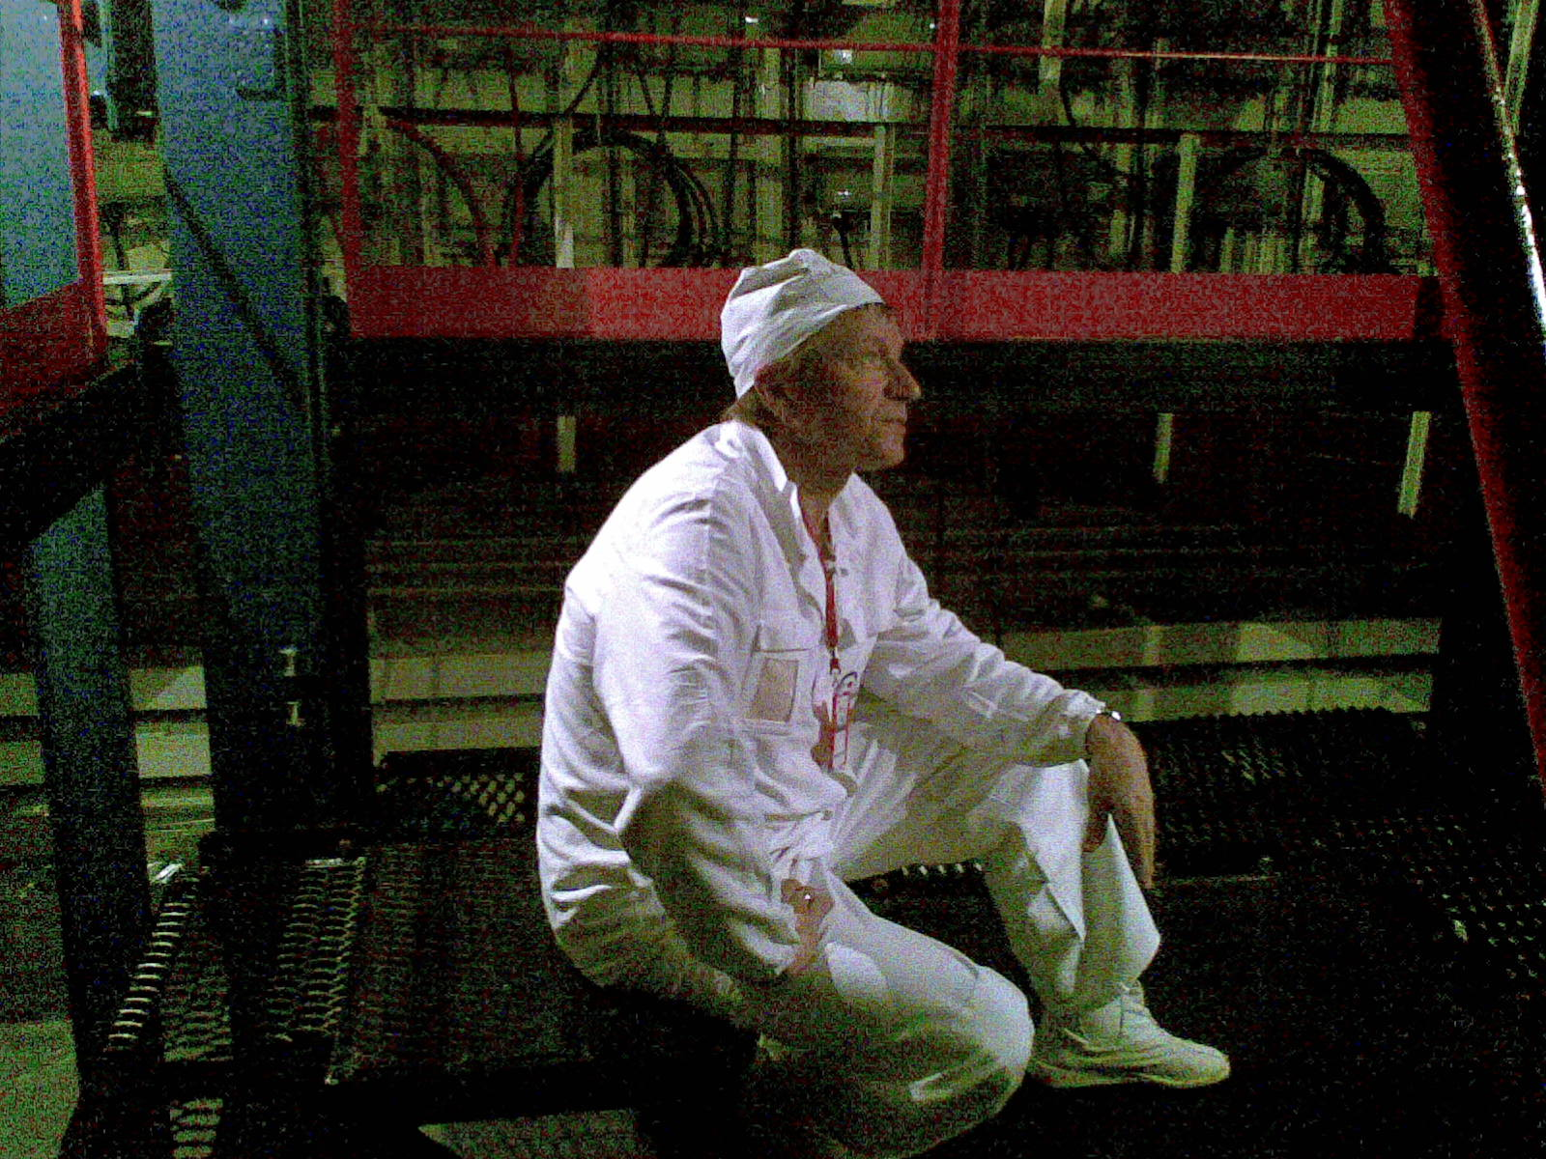
^{Could we make} the same for the DANSS

Slide 47
4.1 m
Lifting mechanism

Slide 48
Important features
(resp. to conventional liquid scint.)
Handling is much safer (not caustic, spontaneously igniting, volatile or solvent) → no restrictions to move the detector very close to the reactor core → higher neutrino flux → better sensitivity.
High segmentation (2500 cells) → space information → better IBD-signature → stronger BCKG suppression.
PS is not doped with Gd, but interlayed with it → better quality and stability of the scintillator.
WLS-fibers improve homogeneity of light-collection → better energy resolution.
Each cell in a module is looked through with both individual MPPC (high QE, but bad noise and range) and common PMT (lower QE, but better range and stability) → coincidence mode and combination of PMT and MPPC advantages.
Sectional structure → possibility of “partial” operation, renewal and upgrade.
Use of lifting mechanism → measurements at different distance → more reliable data interpretation.

Slide 49
Expected parameters:
Sensitive volume: 1 m³
Composition: 5 sections (1m × 1m × 0.2m)
or 10 sections (1m × 1m × 0.1m)
of (5X + 5Y) modules = 2500 scint. strips { 1 module = 5 × 10 = 50 strips }
IBD detection efficiency: 74%
Count rate: 9200 IBD-events per day
Background: 40-50 events per day
Due date: section №0 – Feb 2010
sections №1-3 – 2011 №4-5 – 2012

